Slide 1
Matchbox tool
Quality control for digital collections
Roman Graf Reinhold Huber-Mörk
Research Area Future Networks and Services Research Area Intelligent Vision Systems
Department Safety & Security, AIT Austrian Institute of Technology
Alexander Schindler
Department of Software Technology and Interactive Systems
Vienna University of Technology
SCAPE training event
Guimaraes, Portugal, 6-7 December 2012

Slide 2
Overview
Introduction
Matchbox Tool Description
Image Processing
Collection Samples
Matchbox Tool Features
Training Description
Installation Guidelines
Practical Exercises and Tool Analysis Results
Conclusion

Slide 3
Introduction
High storage costs
Update of digitized collection through an automatic scanning process
Use case: Find Duplicates
No automatic method to detect duplicates in not structured collections
Lack expertise and efficient methods for finding images in a huge collection
Need for automated solutions
QA is required to select between the old and new
Decision support - overwrite or human inspection
Image: d = 40.000 SIFT descriptors, book: n = 700 images
SIFT: d² = 1.6×10⁹ vector comparisons for a single pair of images
BoW typical book: clustering, n×(n - 1) = 350.000 vector comparisons

Slide 4
Matchbox Tool Description
Tool
  C++ (DLLs on Windows or shared objects on Linux)
Dataset
  Austrian National Library - Digital Book Collection (about 600.000 books that will be digitized over the coming years)
Main tasks
  Overwriting existing collection items with new items
  Image pairs can be compared within a book
Output
  Visual dictionary for further analysis
  Duplicates

Slide 5
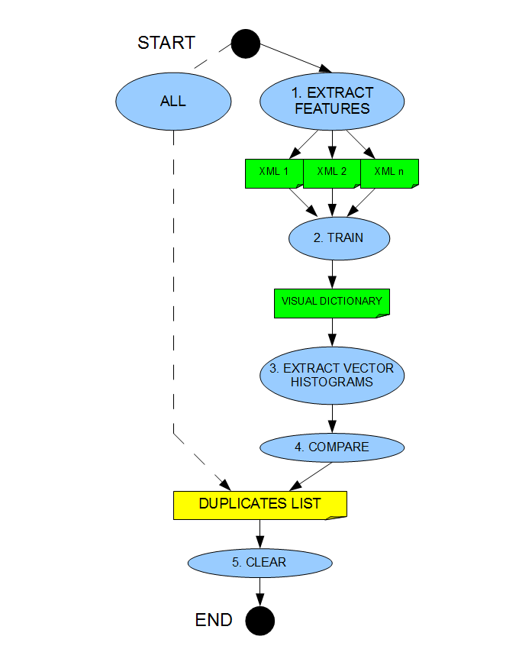
Image Processing
Document feature extraction
  Interest keypoints - Scale Invariant Feature Transform (SIFT)
  Local feature descriptors (invariant to geometrical distortions)
Learning visual dictionary
  Clustering method applied to all SIFT descriptors of all images using k-means algorithm
  Collect local descriptors in a visual dictionary using Bag-Of-Words (BoW) algorithm
Create visual histogram for each image document
Detect similar images based on visual histogram and local descriptors. Structural SIMilarity (SSIM) approach
  Rotate
  Scale
  Mask
  Overlaying

Slide 6
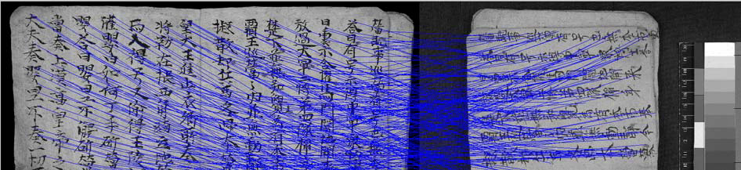
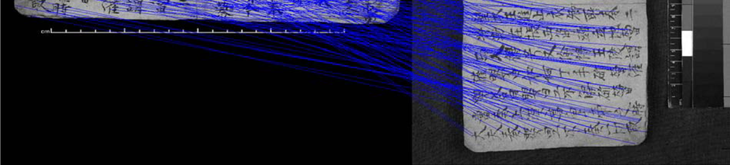
Matching of keypoints

Slide 7
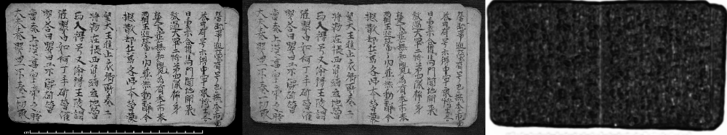
Pixel wise comparison - SSIM

Slide 8
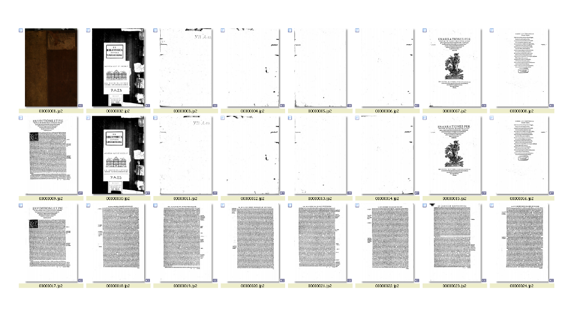
Images 10 to 17 are duplicates of images 2 to 9

Slide 9
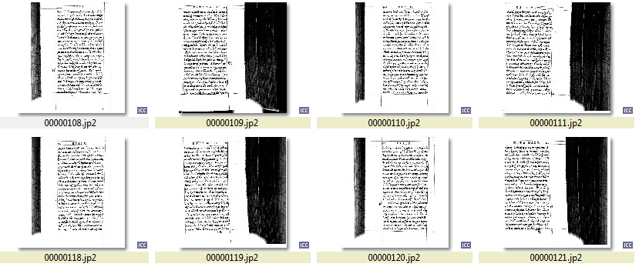
High similarity but no duplicates

Slide 10
Matchbox Tool Features
Reduce costs
Improves quality
Saves time
Automatically
Increase efficiency of human work with particular focus
Invariant to format, rotation, scale, translation, illumination, resolution, cropping, warping, distortions
Application: assembling collections, missing files, duplicates, compare two images independent from format (profile, pixel)

Slide 11
Training Description
Goal: to be able to detect duplicates in digital image collections
Outcomes of training: learn how to install the matchbox and how to set up associated workflows.
Teacher activity:
  Tool presentation
  Carry out a number of duplicate detection experiments
Attendee activity: complete some workflows for
  Image duplicate search
  Content-based image comparison
  Customize duplicate search workflow
  Understand and describe outputs of different commands

Slide 12
Installation Guidelines
Linux OS with more than 10GB disk and 8GB RAM
Git
Python2.7
Cmake
C++ compiler
The newest OpenCV version
Matchbox HTTP URL: https://github.com/openplanets/scape.git or download ZIP from the same page (“pc-qa-matchbox”)
Digital collection should have at least 15 files in order to build BoW

Slide 13
Practical Exercises
Identifying duplicate images in digital collections
  Move digital collection to the server where matchbox is installed. For Windows use pscp, WinScp or Web Interface.
  cd scape/pc-qa-matchbox/Python directory in matchbox source code
  sudo python2.7 ./FindDuplicates.py /home/matchbox/matchbox-data/ all --help
  Define which step of the workflow should be executed: all, extract, compare, train, bowhist, clean
  Optional parameters are not supported yet
  Correct command sequence if not "all“:
    clean
    extract
    train
    bowhist
    Compare

Slide 14
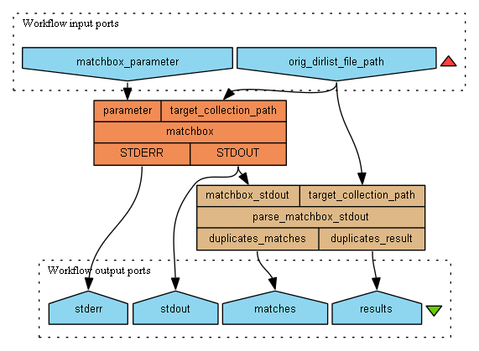
Scenario: professional duplicate search

Slide 15
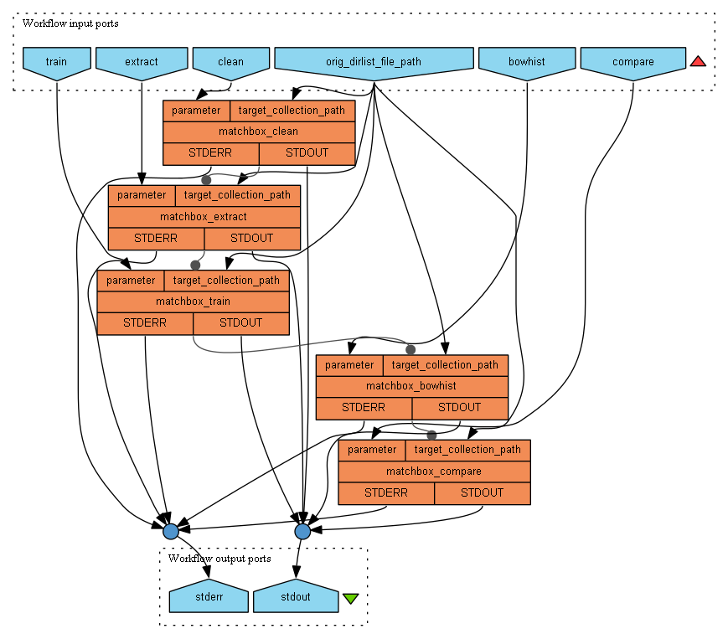
Scenario: find duplicates using nested commands

Slide 16
Analysis of the Tool Results
[1 of 20] 1
[2 of 20] 2 => [10]
[3 of 20] 3
[4 of 20] 4
[5 of 20] 5
[6 of 20] 6
[7 of 20] 7 => [15]
[8 of 20] 8 => [16]
[9 of 20] 9 => [17]
[10 of 20] 10 => [2]
[11 of 20] 11
[12 of 20] 12
[13 of 20] 13
[14 of 20] 14
[15 of 20] 15 => [7]
[16 of 20] 16 => [8]
[17 of 20] 17 => [9]
[18 of 20] 18
[19 of 20] 19
[20 of 20] 20
3,4,5,6 with associated duplicates 11,12,13,14 are nearly empty pages
compare.exe -l 4 /root/samples/matchboxCollection/00000012.jp2.SIFTComparison.feat.xml.gz /root/samples/matchboxCollection/00000003.jp2.SIFTComparison.feat.xml.gz
OpenCV Error: Assertion failed (CV_IS_MAT(points1) && CV_IS_MAT(points2) && CV_ARE_SIZES_EQ(points1, points2)) in cvFindFundamentalMat, file /root/down/OpenCV-2.4.3/modules/calib3d/src/fundam.cpp, line 599

Slide 17
Practical Exercises
Output for collection with multiple duplicates:
=== compare images from directory /root/samples/col_multiple_dup/ ===
...loading features
...calculating distance matrix
[1 of 16] 92
[2 of 16] 85 => [77, 79, 81, 83]
[3 of 16] 82 => [78, 80, 84]
[4 of 16] 78 => [80, 82, 84]
[5 of 16] 87
[6 of 16] 89
[7 of 16] 86
[8 of 16] 88
[9 of 16] 79 => [77, 81, 83, 85]
[10 of 16] 91
[11 of 16] 90
[12 of 16] 83 => [77, 79, 81, 85]
[13 of 16] 84 => [78, 80, 82]
[14 of 16] 81 => [77, 79, 83, 85]
[15 of 16] 77 => [79, 81, 83, 85]
[16 of 16] 80 => [78, 82, 84]

Slide 18
Practical Exercises
Compare two images by profile information
  extractfeatures /home/matchbox/matchbox-data/00000001.jp2
  extractfeatures /home/matchbox/matchbox-data/00000002.jp2
  compare /home/matchbox/matchbox-data/00000001.jp2. ImageProfile.feat.xml.gz /home/matchbox/matchbox-data/00000002.jp2.ImageProfile.feat.xml.gz
  Output:
    <?xml version="1.0"?>
    <comparison>
    <task level="2" name="ImageProfile">
    <result>0.000353421</result> => high similarity
    </task>
    </comparison>
    <?xml version="1.0"?>
    <comparison>
    <task level="2" name="ImageProfile">
    <result>14.1486</result> => low similarity
    </task>
    </comparison>

Slide 19
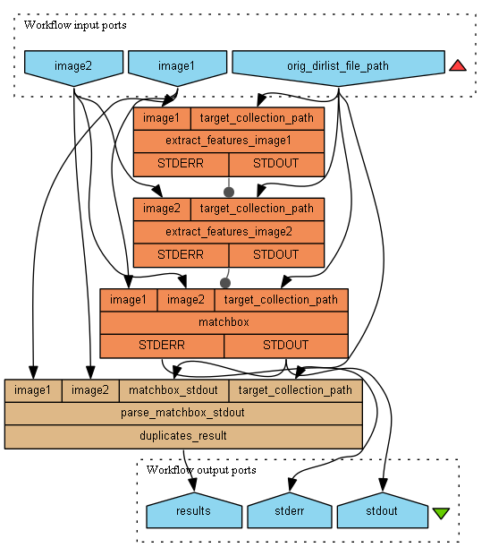
Scenario: compare image pair based on profiles

Slide 20
Practical Exercises
Compare two images based on SSIM method
  python2.7 FindDuplicates.py /root/samples/matchboxCollection/ --img1=00000001.jp2 --img2=00000002.jp2 compareimagepair
  Output:
=== compare image pair 00000001.jp2 00000002.jp2 from directory /samples/matchboxCollection/ ===
dir: /root/samples/matchboxCollection/
img1: /root/samples/matchboxCollection/00000001.jp2.BOWHistogram.feat.xml.gz
img2: /root/samples/matchboxCollection/00000002.jp2.BOWHistogram.feat.xml.gz
...calculating distance matrix
[1 of 2] 71 => if images are not duplicates
[1 of 2] 1 => [2] => if images are duplicates

Slide 21
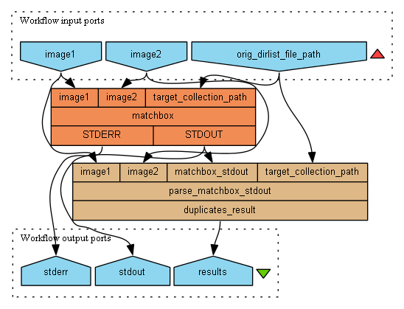
Scenario: check duplicate pair using SSIM

Slide 22
Practical Exercises
Exercise: Identifying duplicate images in digital collections
  You have a collection of 20 digital documents. Write a command to search duplicates in one turn
  Write commands to search duplicates using customized workflow
  Describe outputs
Exercise: Identifying multiple duplicates in digital collection
  You have a collection that contains multiple duplicates of one document. Write a command to detect all these duplicates
  Describe outputs
Exercise: Compare two images
  You have analyzed a collection of 20 digital documents. Write a command to perform a content-based comparison of two particular documents
  Describe outputs

Slide 23
Conclusion
Decision making support for duplicate detection in document image collections
An automatic approach delivers a significant improvement when compared to manual analysis
The tool is available as Taverna components for easy invocation and testing
System ensures quality of the digitized content and supports managers of libraries and archives with regard to long term digital preservation

Slide 24
Thank you for your attention!

