Slide 1



How to share your workflow
Collaborating via the myExperiment Repository
Donal Fellows
School of Computer Science, The University of Manchester
SCAPE Project Training: Future Formats First
British Library, London, 16–17 September 2013

Slide 2
Workflows in Wider Use
Workflows encode a way of performing some complex action
  Typically multiple steps
  Typically complex intermediate values
  Often simpler inputs and results
Valuable to share with others
  Collaboration when creating
  Feedback on whether workflow does right thing
  Telling others what you’ve done

Slide 3
Collaboration Repository
Collaboration through myExperiment Repository
  Designed to hold workflows
  Manages user groups
  Manages permissions
  Manages licensing
  Provides longer-term store
Can associate auxiliary files and links with workflow
  Usage manuals
  Papers
  Articles
Integrated with Taverna Workbench

Slide 4
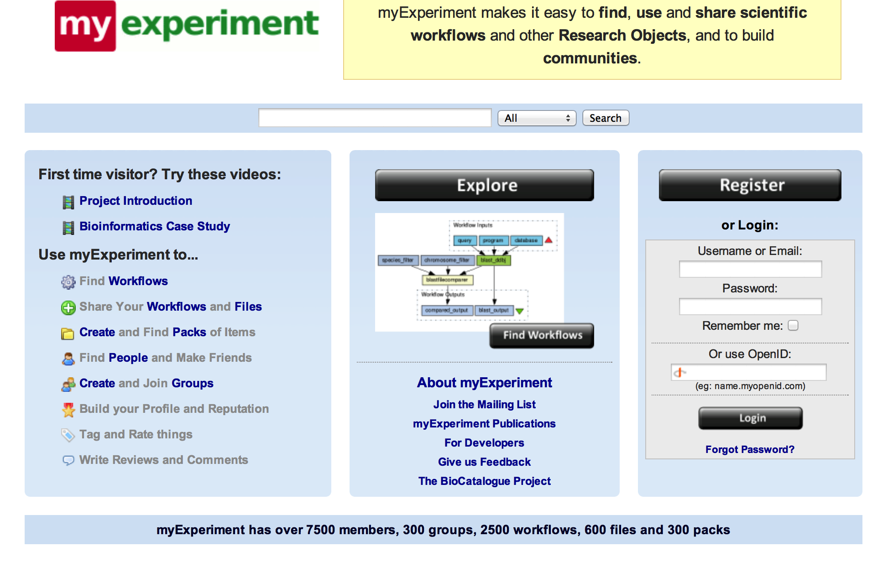
http://www.myExperiment.org/

Slide 5
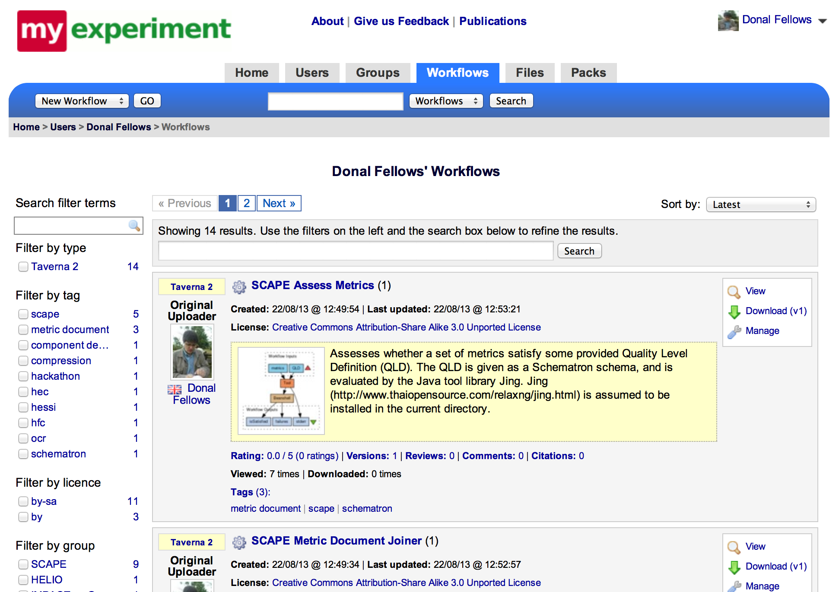
My Workflows

Slide 6
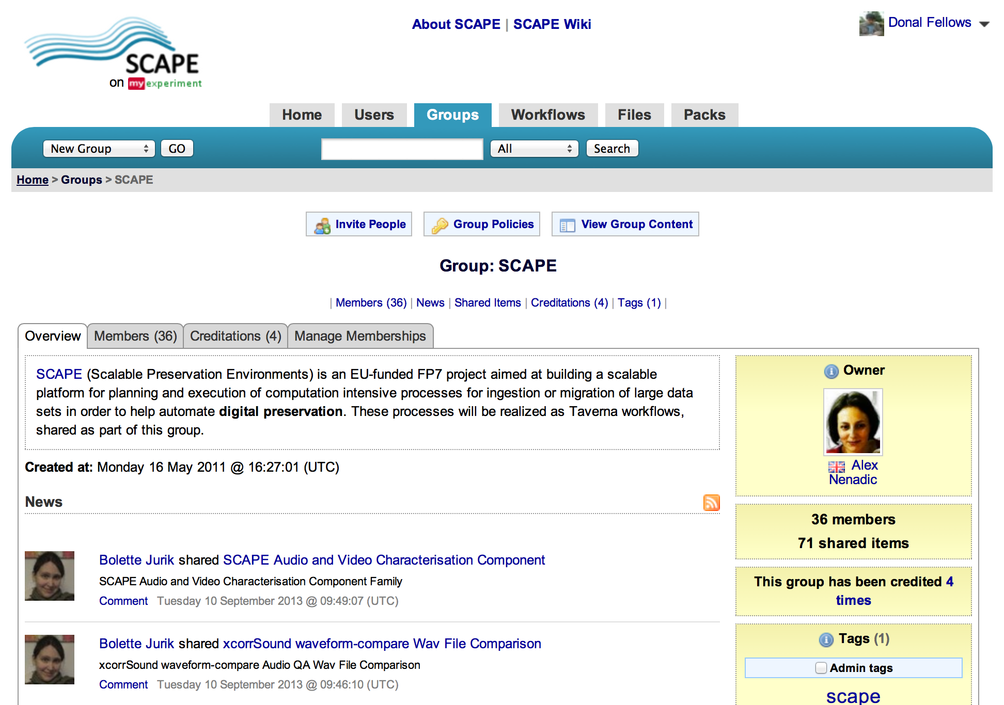
SCAPE Group on myExperiement

Slide 7
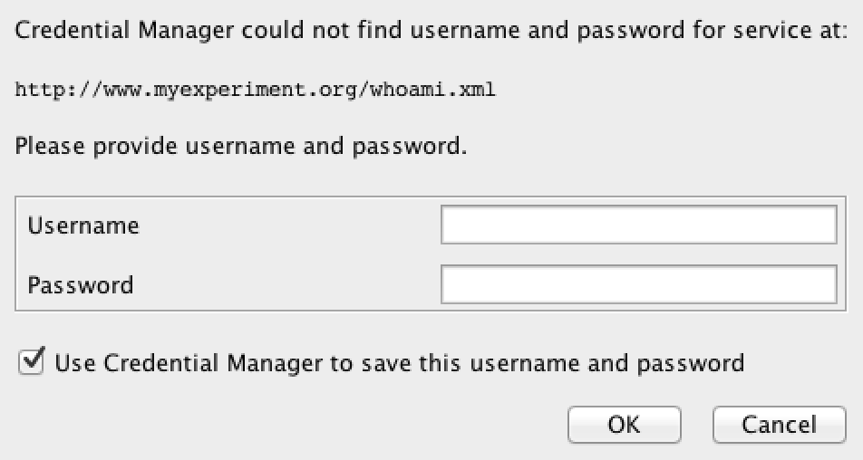
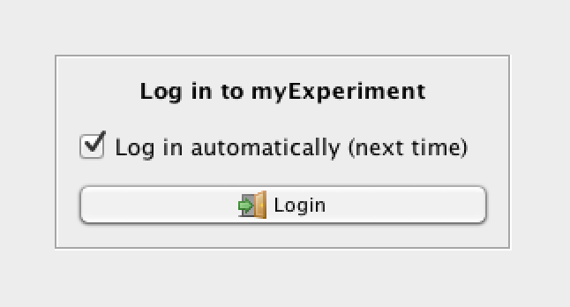
Using myExperiment in Taverna Workbench
Create an account
  TIP: Use username/password, not OpenID
  TIP: You can have your display name not be your username
Switch to Taverna myExperiment Perspective
  Log in with username/password

Slide 8
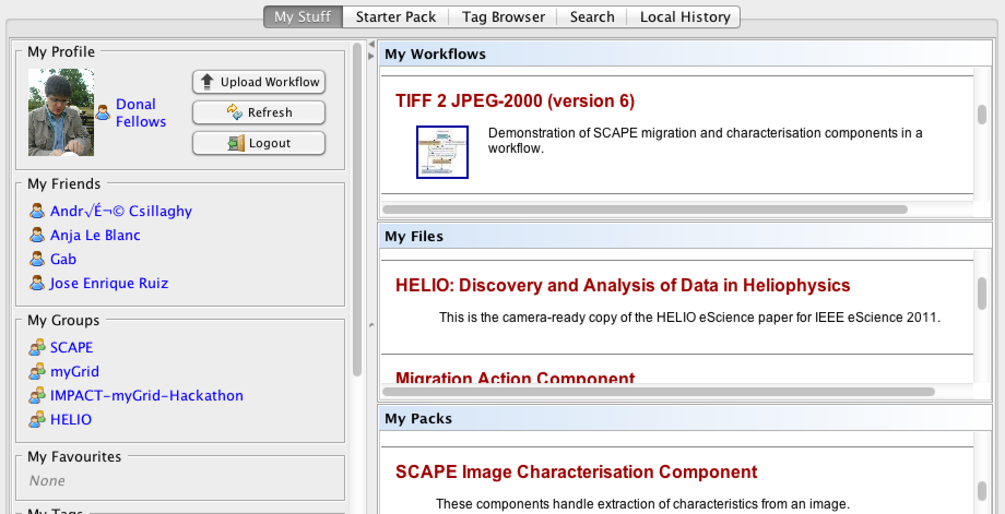
Using myExperiment in Taverna Workbench
Now get Taverna view of myExperiment

Slide 9
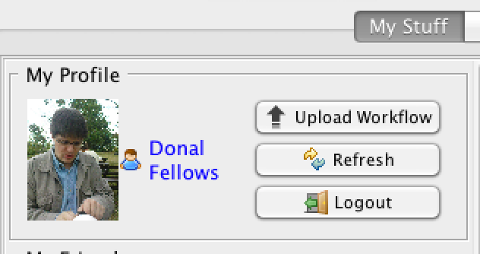
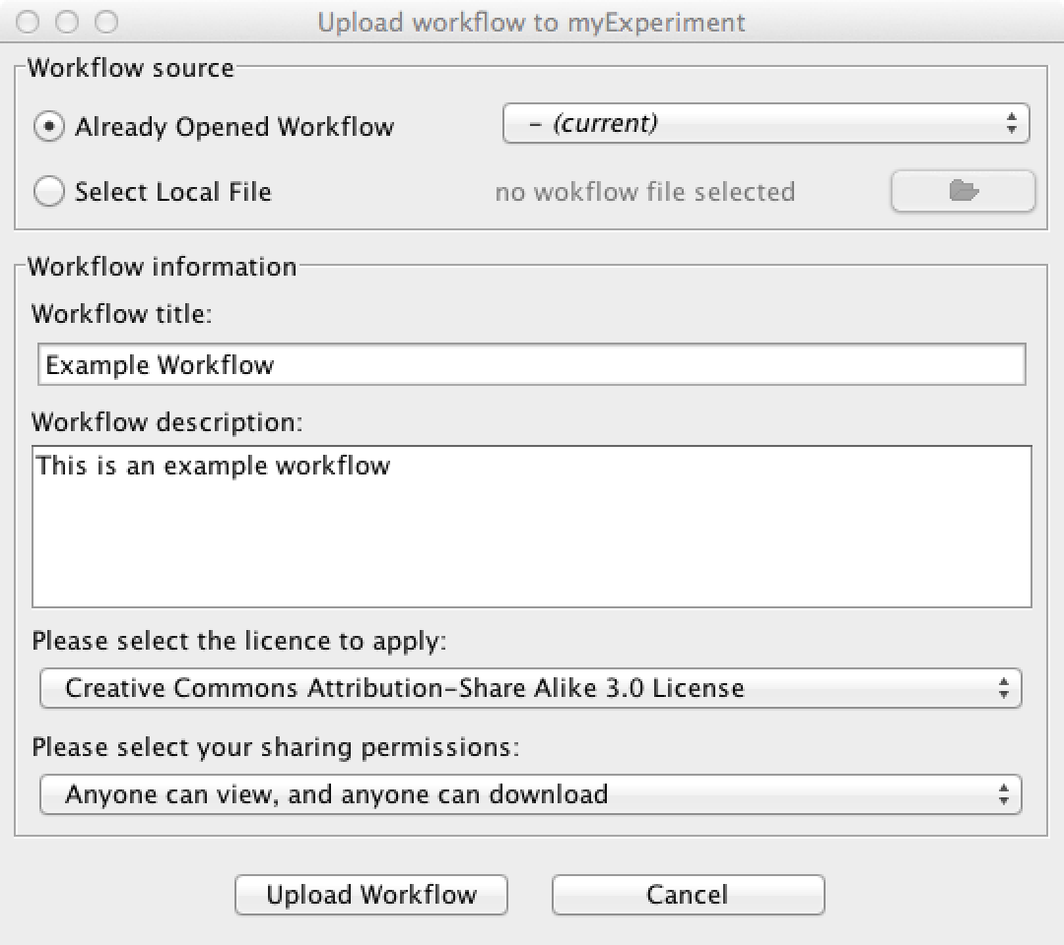
Uploading a Workflow
Create the workflow
  Use the Design Perspective
Click “Upload Workflow”
  Opens dialog
Fill in the form
  Source
    Current workflow or File
  Title
  Description
  License
    CC-SA-3.0 default
  Sharing
    Private default; CHANGE it!
    Want public download

Slide 10
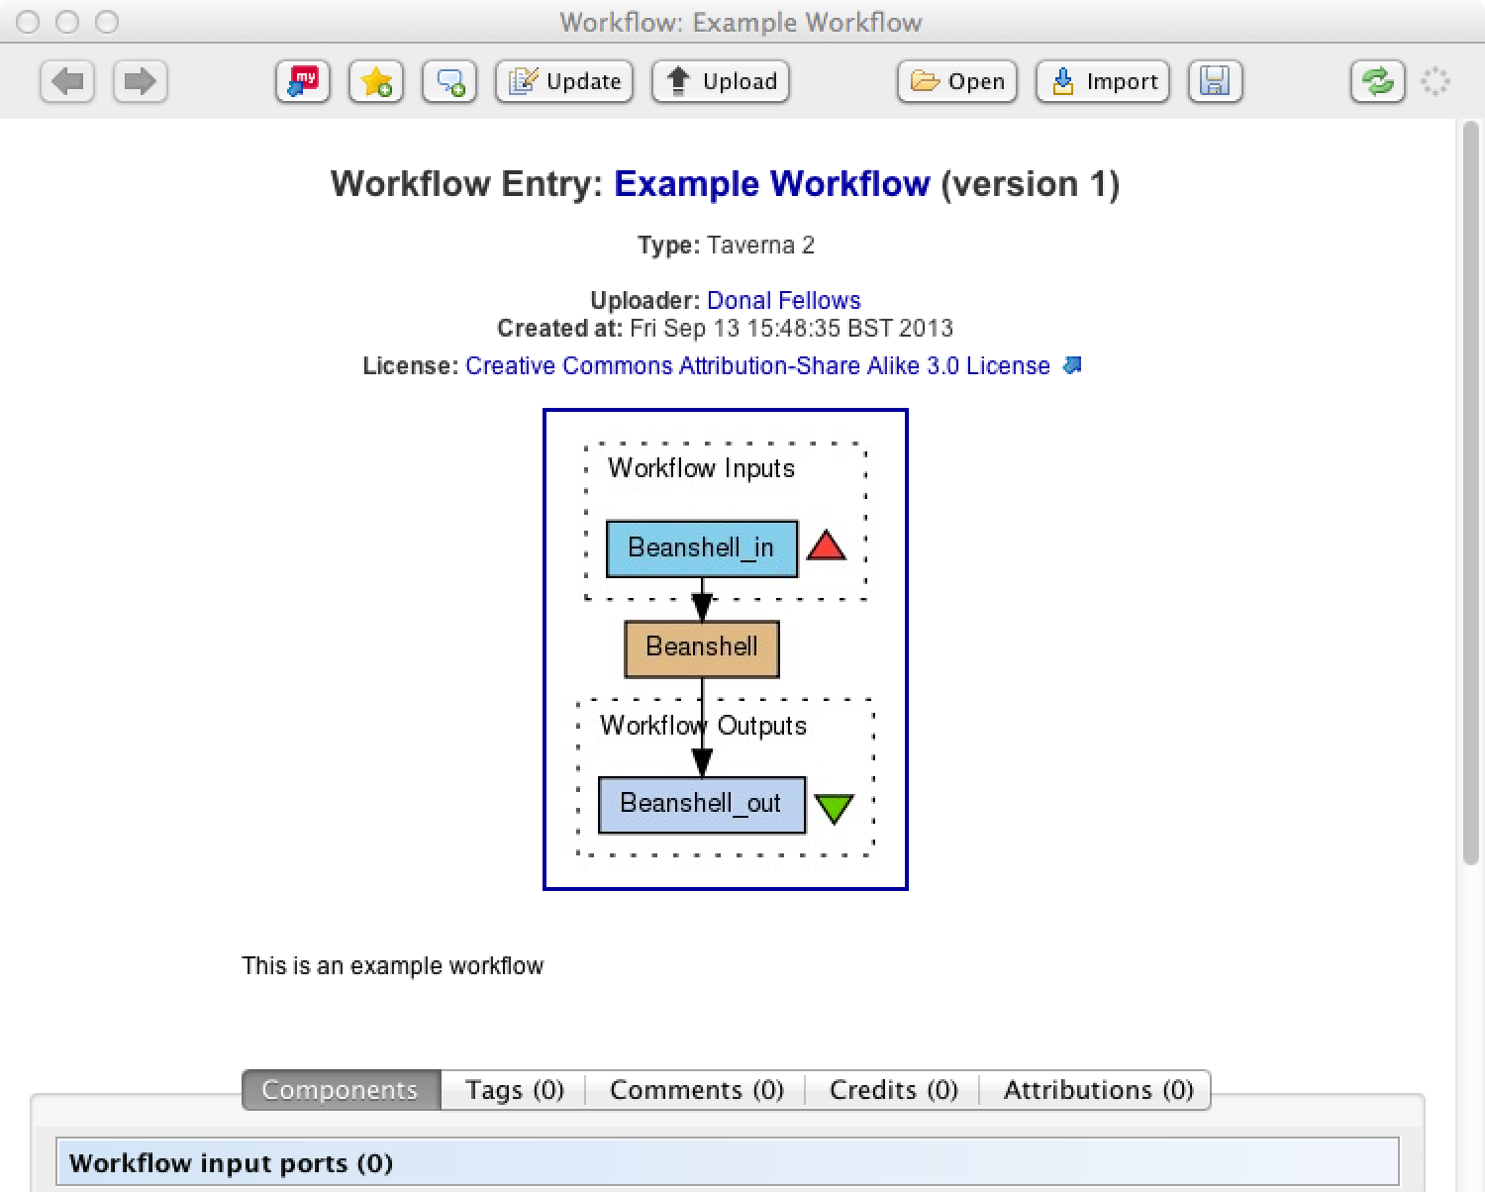
Finding your Workflow
Listed in “My Workflows”
  May need Refresh
May be Searched for
Click Preview (or on title in My Workflows view) to bring up details
Click Open to open as separate workflow
Click Import to include into current workflow
  Advanced feature

Slide 11
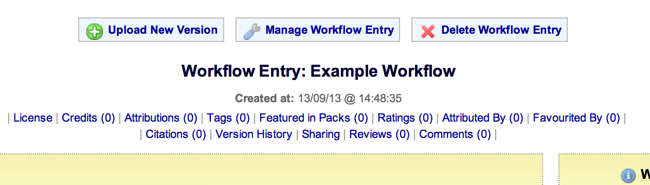
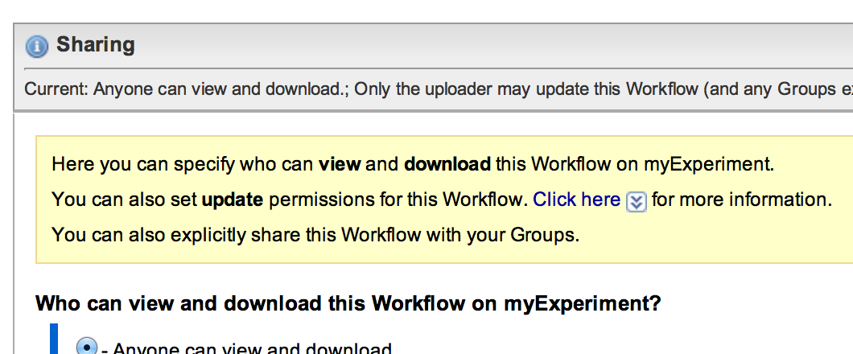
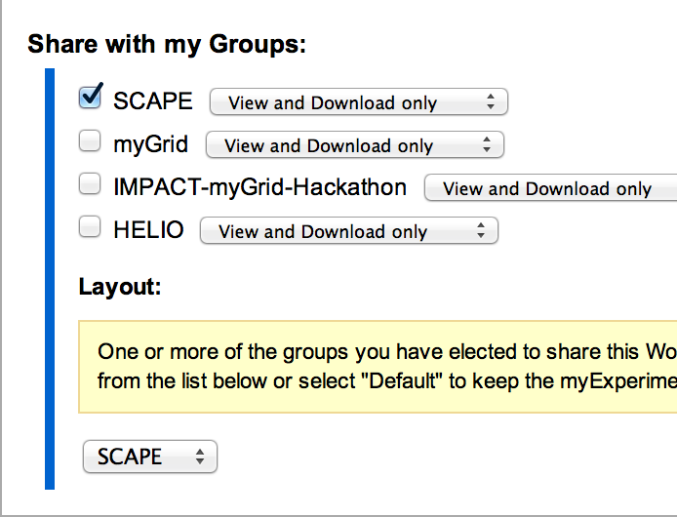
Sharing your Workflow with Others
Must be done through myExperiment website
Navigate to the workflow’s page
Click “Manage Workflow Entry”
Open Sharing section
Manipulate the groups shared with
  Sharing with SCAPE lets you add project theme to workflow page

Slide 12
Any Questions?
URL: http://www.myexperiment.org/
Your tasks:
  Join myExperiment
  Join the SCAPE group
  Upload your workflow from Taverna Workbench
  Share your workflow with SCAPE
  Find someone else’s workflow and open it in Taverna

Slide 13
Not Shown…
Semantic Searching
  Support not yet rolled onto production site
  Still hard to use
    Experimental Taverna Semantic Search UI is very raw unless you know both SPARQL and the profiles and ontologies…
  Profiles to query against under active development

