Slide 1
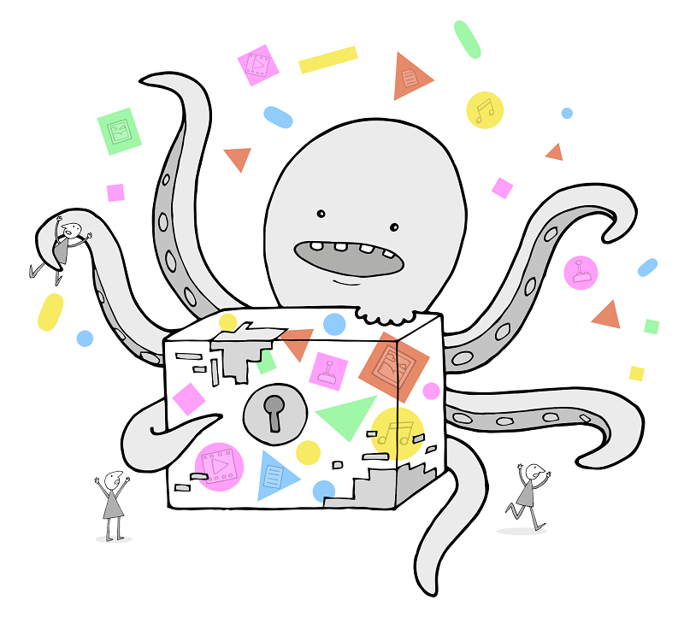
Supporting practical preservation work and making it sustainable with SPRUCE
Paul Wheatley
SPRUCE Project Manager
University of Leeds
@prwheatley
These slides can be found here:
http://bit.ly/spruce-outputs

Slide 2

Some of the things I’m going to talk about
SPRUCE review:
  Results
  Approaches
  Evaluation
Mashups and funding awards
Online collaboration
DP Business Case Toolkit
These slides can be found here:
http://bit.ly/spruce-outputs

Slide 3






The default “about this project” slide...
SPRUCE: Sustainable Preservation Using Community Engagement
Funded by Jisc
Ends November 2013
Aim: to kick start, support and sustain digital preservation activity via a community approach
http://wiki.opf-labs.org/display/SPR

Slide 4
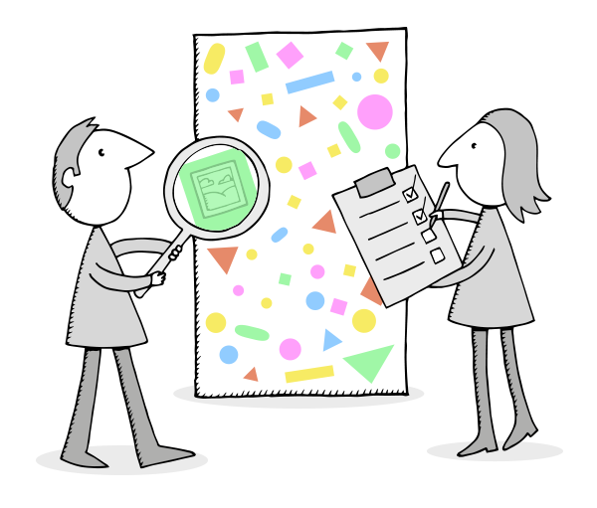
DP collaboration via face to face events: Mashups
3 SPRUCE Mashups
  3 day, agile workshops
  Practitioners bring data
  Developers work with them
  Solve concrete DP challenges
  Business case exercises
Characterisation Hackathon
  Representatives from:
  JHOVE, JHOVE2, DROID, FIDO, C3PO and FITS
  Tika->FITS+C3PO, FF magic, PDF risk
  More on mashups: http://bit.ly/spruce-mashup

Slide 5
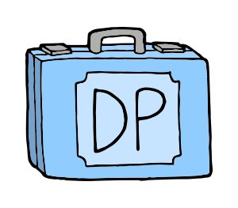
SPRUCE Awards
Follow up funding awards
  £60k distributed in £5k awards
  Short projects building on preservation or business case work from mashups (eligible to event attendees only)
  Final five projects due for completion in November
Project themes:
  User led preservation tool enhancement
  Digital preservation kick starts
  Audits and business cases for further funding
  Media imaging and data stabilisation
  http://bit.ly/spruce-awards

Slide 6




Mashup evaluation
Key successes
  Tackled 90+ digital preservation challenges
  Got techies talking effectively with non-techies
  Advanced understanding for experts
  Got newbies up and running
  Staff development
Lasting impact?
  Changed attitudes
  Better ways of working: learning by doing, agile, tool re-use
  Captured and shared the results: good, bad, and the data
But...have we sustained the community
beyond the events?

Slide 7
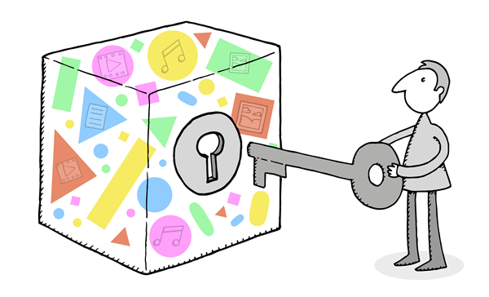
Online Approaches to Collaboration
Three key aims:
  Develop the community – get people working together more effectively and increase awareness of others skills and others work that can be exploited
  Develop some shared DP resources
  Tackle some key “collaboration fails”
Experimental...
  Explore and learn the lessons
All are collaborations in themselves, not “SPRUCE” initiatives
http://bit.ly/spr-collaborate

Slide 8
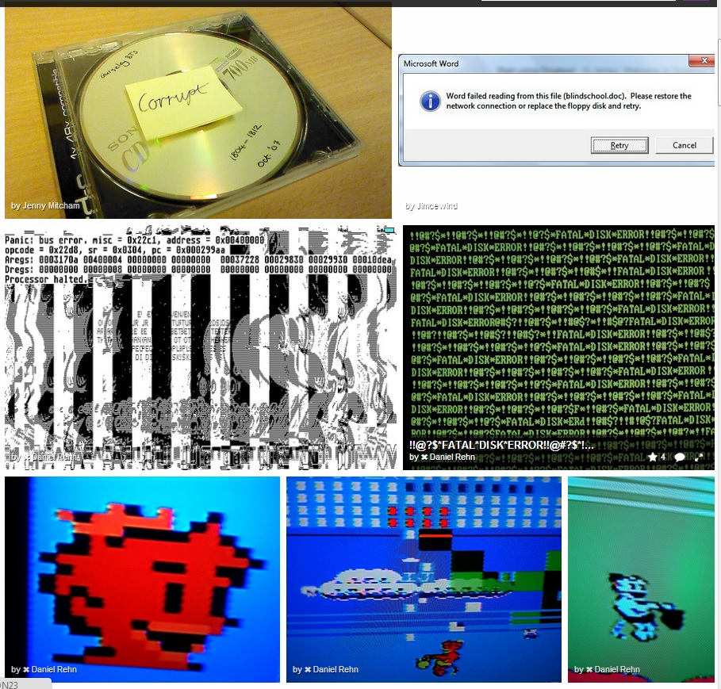
Atlas of Digital Damages
Atlas Flickr group
Also see Barbara Sierman’s site

Slide 9
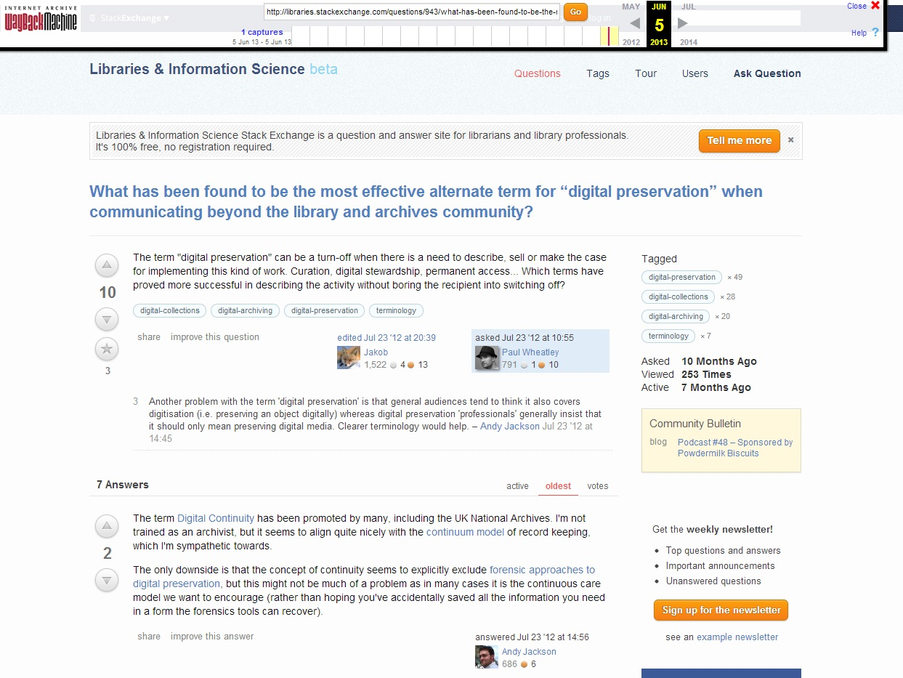
DP Question and Answer site
Now resides in the Internet Archive

Slide 10
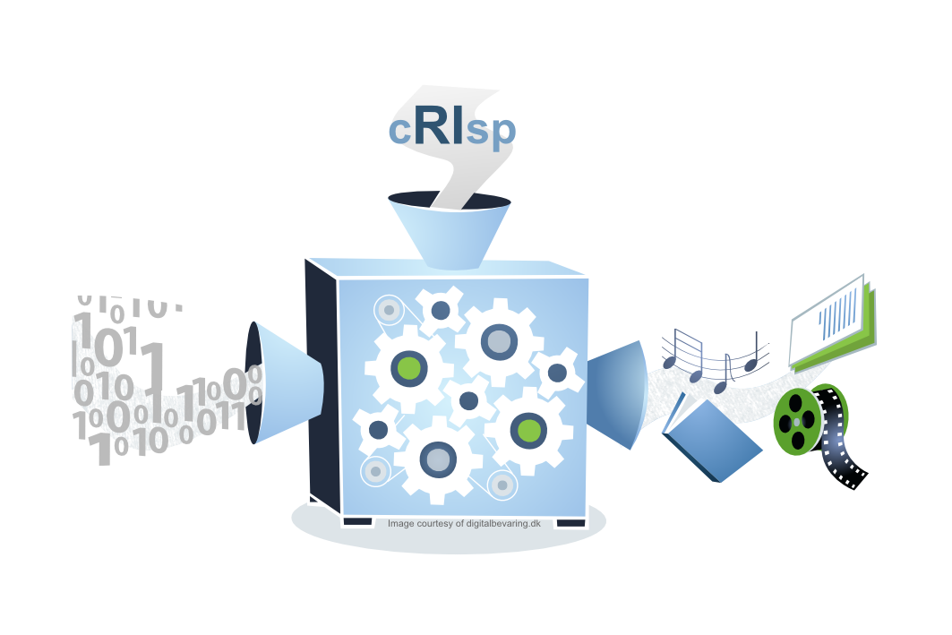
RI and File Format Initiatives
cRIsp: Crowd sourced Representation Information for Supporting Preservation
Just Solve
OPF File Format risks

Slide 11
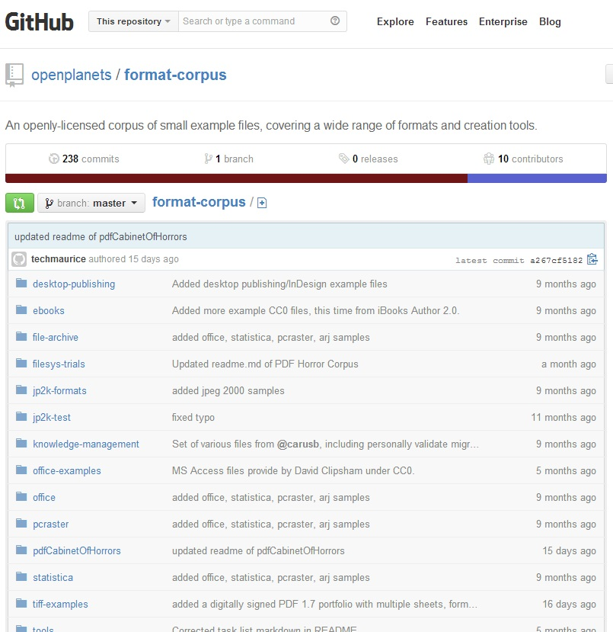
OPF Format Corpus
OPF Format Corpus

Slide 12
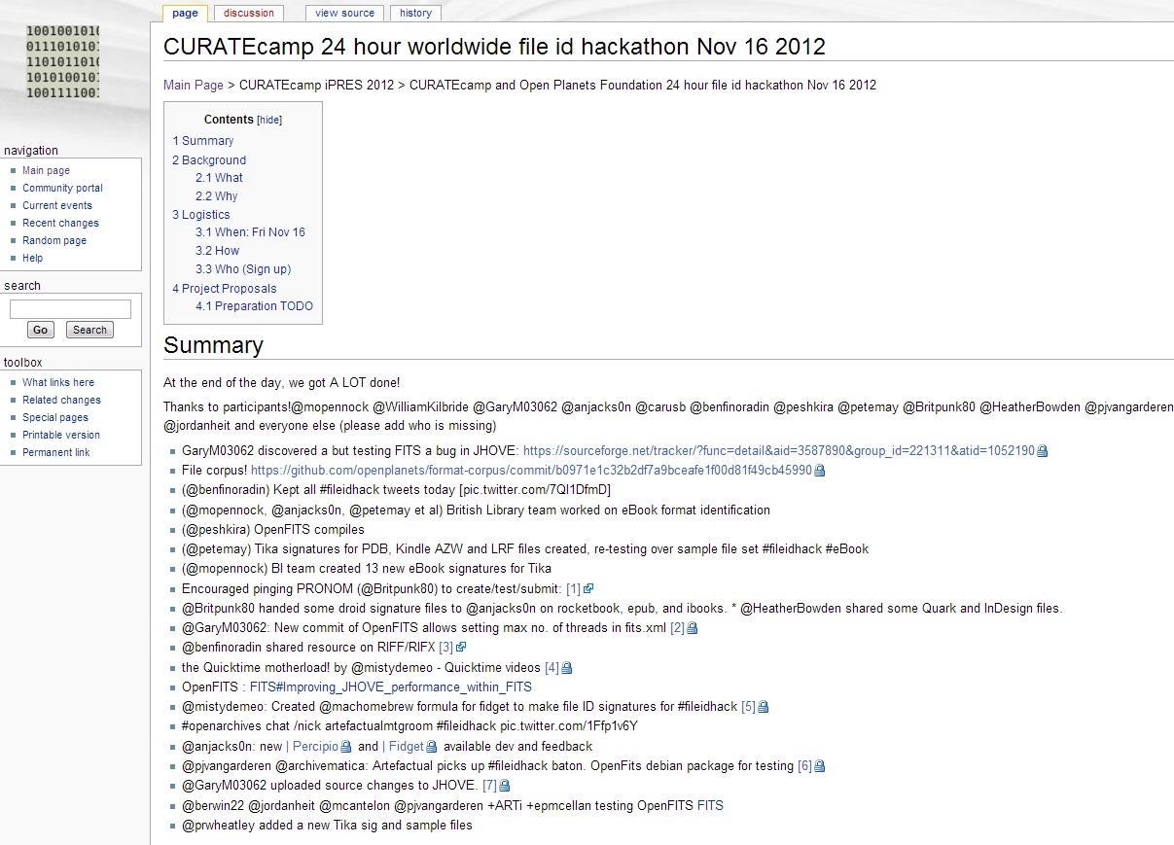
#fileidhack: 24 hour file format id hackathon
#fileidhack 24 hour file id hackathon

Slide 13

COPTR
COPTR: Community Owned digital Preservation Tool Registry

Slide 14
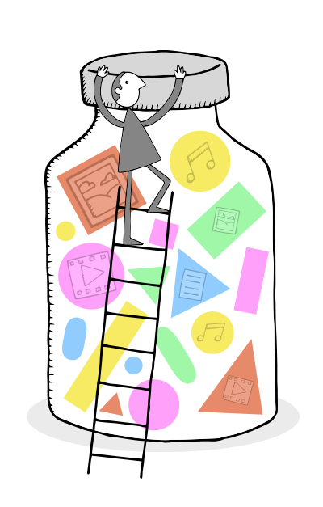
Evaluation and Lessons Learned
Successes often due to enthusiastic individuals
Little formal institutional support
  Reluctance to contribute effort beyond institution’s URL
Community: more talk than action?
  Only a quarter of committers actually visited DP Stack
Re-using existing technology: collaboration with a minimum of effort
  Flickr, Github, Justsolve
Twitter conversations critical

Slide 15
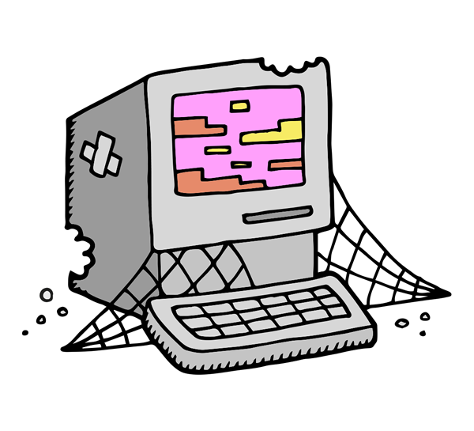
Conclusions? *My* thoughts...
Persevere
Change mindsets
Demonstrate value of successes
Encourage those little contributions
DPC and OPF (and others) have taken some inspiration from SPRUCE approach
Online collaborative events
Review format/RI registry initiatives
Community “manager” role
What role will ANADP(2) play?

Slide 16
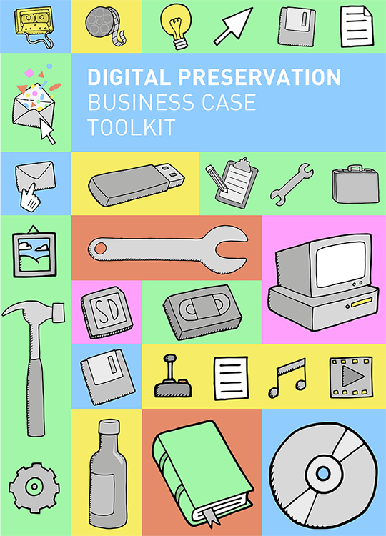
Digital Preservation Business Case Toolkit
Encourage new DP activity
Help sustain existing DP activity
http://wiki.dpconline.org

Slide 17
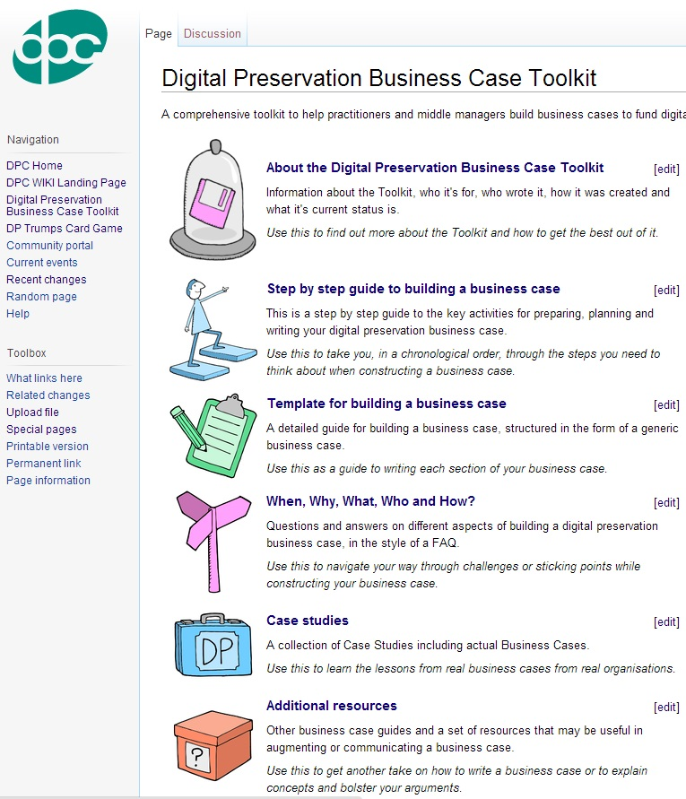
Making the case to fund digital preservation
No simple formula
Multiple approaches
  Step by step guide
  Case template
  FAQ
Case studies and real business cases
Trial in 2 further case studies

Slide 18
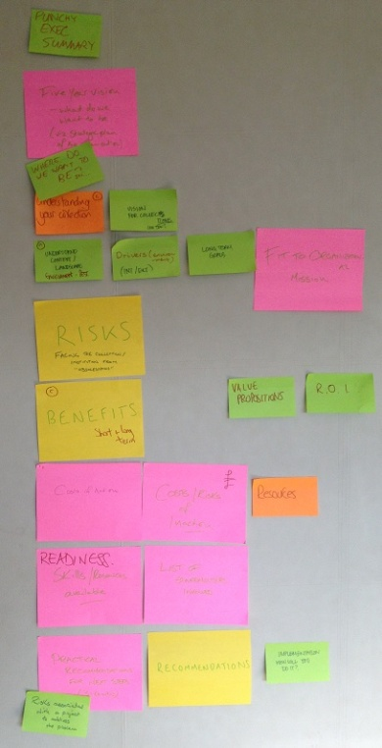
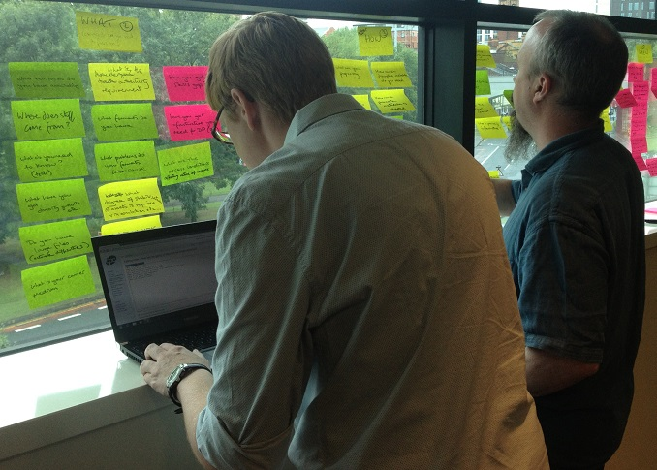
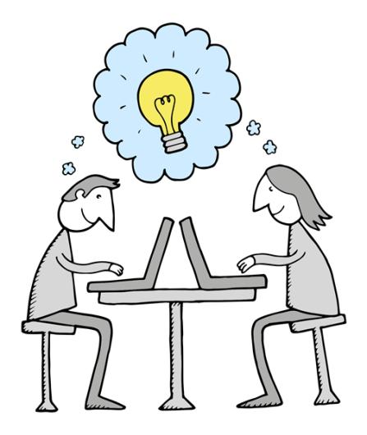
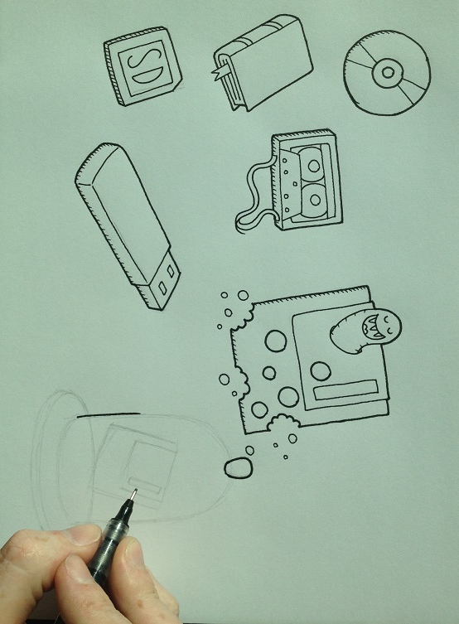
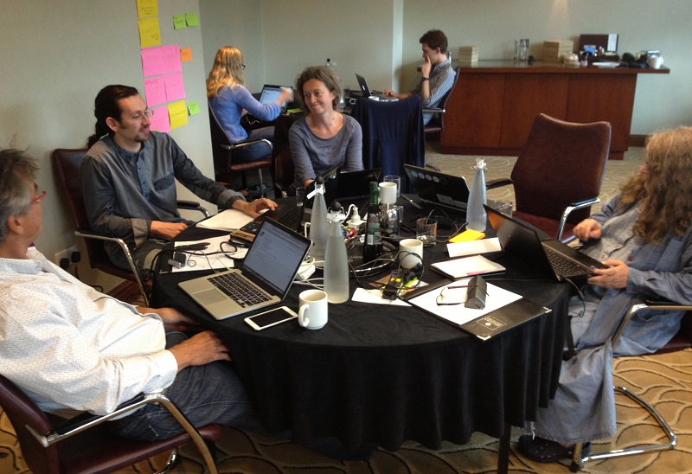
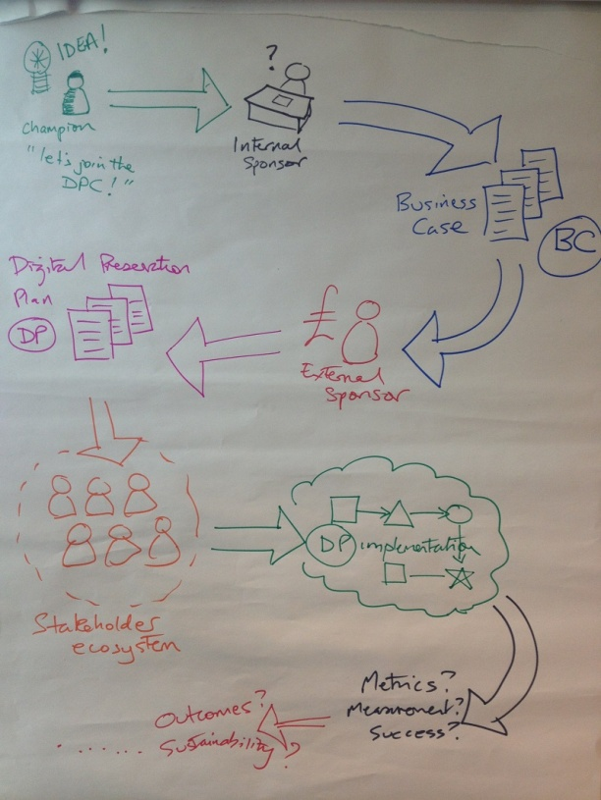
Book sprint

Slide 19

What happens next? The “S” word
SPRUCE’s project sustainability approaches:
  Partner with a preservation organisation
  Project website on organisational wiki(s)
  Make it user driven (and hence useful)
  CC licensing
  Process outputs well described and
  published (eg. mashups and approach)
  Clear and concise list of key outputs
Detailed blog post on this topic
coming soon...

Slide 20


Questions?
Thanks to the SPRUCE Team:
Bo Middleton, University of Leeds
William Kilbride, Digital Preservation Coalition
Maureen Pennock, British Library
Bram van der Werf, Open Planets Foundation
Ed Fay, London School of Economics
Jodie Double, University of Leeds
Carl Wilson, Open Planets Foundation
Becky McGuiness, Open Planets Foundation
Beccy Shipman, University of Leeds
Paul Wheatley
SPRUCE Project Manager
University of Leeds
@prwheatley
These slides can still be found here: http://bit.ly/spruce-outputs
Cartoon illustrations are by Tom Woolley and are available for re-use under a CC-BY-NC license as part of the:
Digital Preservation Business Case Toolkit http://wiki.dpconline.org/

