Slide 1
Content Profiling and C3PO
Artur Kulmukhametov
Vienna University of Technology
SCAPE PW Training Event
Aarhus, 13-14 November 2013

Slide 2
Agenda
Motivation: collection scale and heterogeneity
An approach to getting a control
Characterisation tools
C3PO, a tool for content profiling

Slide 3
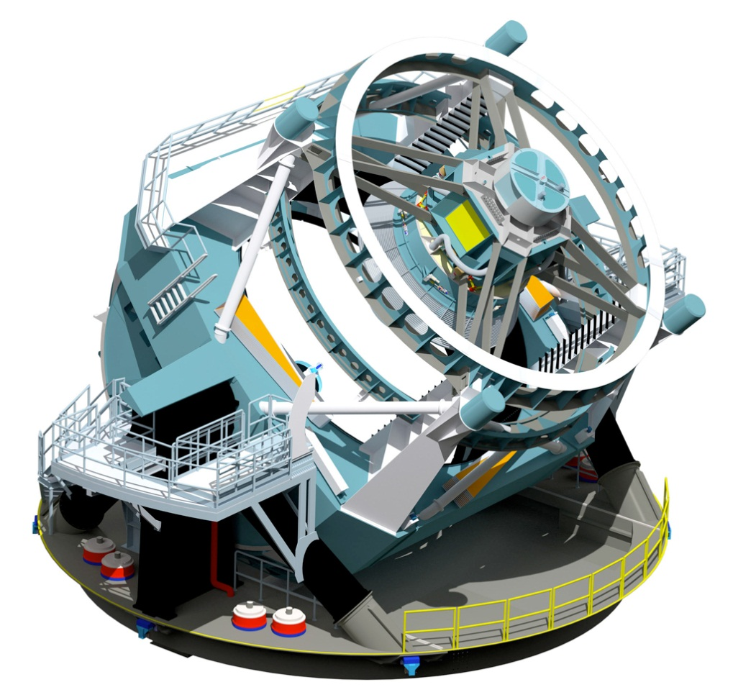
What is it?
*
*
- P. Petrov, Content Profiling and Planning, SCAPE Training Event. Guimarães, 2012

Slide 4
Large Synoptic Survey Telescope
*
30 Terabytes of data nightly
*
- P. Petrov, Content Profiling and Planning, SCAPE Training Event. Guimarães, 2012

Slide 5
Variety of Data
Personal
Cultural Heritage
Scientific Data
Government Documents
…. a huge variety of formats and information

Slide 6
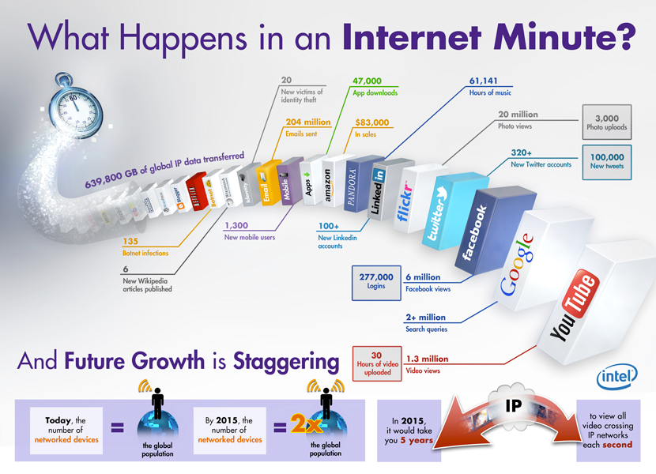
*
*
- P. Petrov, Content Profiling and Planning, SCAPE Training Event. Guimarães, 2012

Slide 7
Conclusions?
….. that’s a lot of data ……
Do you know what that data is?
Do you want to do something with it?

Slide 8
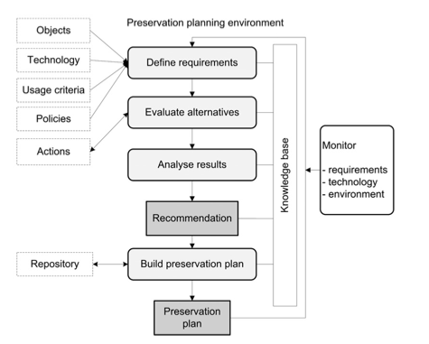
Place for Characterization
*
*
- P. Petrov, Content Profiling and Planning, SCAPE Training Event. Guimarães, 2012

Slide 9

Characterization
*
*
- P. Petrov, Content Profiling and Planning, SCAPE Training Event. Guimarães, 2012

Slide 10
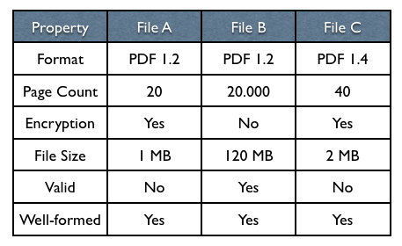
Characterization
*
*
- P. Petrov, Content Profiling and Planning, SCAPE Training Event. Guimarães, 2012

Slide 11
Characterization
*
! One size does not fit all !
*
- P. Petrov, Content Profiling and Planning, SCAPE Training Event. Guimarães, 2012

Slide 12
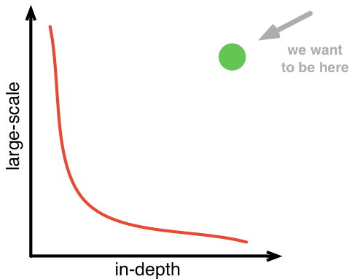
Scalability
*
*
- P. Petrov, Content Profiling and Planning, SCAPE Training Event. Guimarães, 2012

Slide 13






Tools for Characterization
fido
Exif
jpylyzer
ffident
Exiftool
Droid

Slide 14
A few Problems…
A lot of tools to manage and invoke
Different output schemas
Different conﬁguration/environments
No or bad higher level management
Difﬁcult to spot differences

Slide 15
File Information Tool Set
FITS is a software designed to identify, validate, and extract technical metadata for various file formats
By Harvard University Library in 2009
v0.6.2, LGPL
Wraps other tools
New version every 6-12 months

Slide 16
File Information Tool Set
Main features:
FITS includes:
Consolidates output
Can include raw output
Conﬁgurable/Extendable
Droid
Metadata Extra
Jhove
Exiftool
FFident
File Utility
http://code.google.com/p/fits/

Slide 17
FITS Output
<ﬁts xmlns="http://hul.harvard.edu/ois/xml/ns/ﬁts/ﬁts_output" xmlns:xsi="http://www.w3.org/2001/XMLSchema-instance" xsi:schemaLocation="http://hul.harvard.edu/
ois/xml/ns/ﬁts/ﬁts_output http://hul.harvard.edu/ois/xml/xsd/ﬁts/ﬁts_output.xsd" version="0.6.0" timestamp="12/27/11 10:49 AM">
<identiﬁcation>
<identity format="Portable Document Format" mimetype="application/pdf" toolname="FITS" toolversion="0.6.0">
<tool toolname="Jhove" toolversion="1.5" />
<tool toolname="ﬁle utility" toolversion="5.03" />
<tool toolname="Exiftool" toolversion="7.74" />
<tool toolname="NLNZ Metadata Extractor" toolversion="3.4GA" />
<tool toolname="fﬁdent" toolversion="0.2" />
<version toolname="Jhove" toolversion="1.5">1.4</version>
<externalIdentiﬁer toolname="Droid" toolversion="3.0" type="puid">fmt/18</externalIdentiﬁer>
</identity>
</identiﬁcation>
<ﬁleinfo>
<size toolname="Jhove" toolversion="1.5">39586</size>
<creatingApplicationName toolname="NLNZ Metadata Extractor" toolversion="3.4GA" status="SINGLE_RESULT">/XPP</creatingApplicationName>
<lastmodiﬁed toolname="Exiftool" toolversion="7.74" status="SINGLE_RESULT">2011:12:27 10:44:28+01:00</lastmodiﬁed>
<created toolname="Exiftool" toolversion="7.74" status="SINGLE_RESULT">2002:04:25 13:02:24Z</created>
<ﬁlepath toolname="OIS File Information" toolversion="0.1" status="SINGLE_RESULT">/home/petrov/taverna/tmp/000/000009.pdf</ﬁlepath>

Slide 18
FITS Output Conflict
<?xml version="1.0" encoding="UTF-8"?>
<fits xmlns="http://hul.harvard.edu/ois/xml/ns/fits/fits_output" xmlns:xsi="http://www.w3.org/2001/XMLSchemainstance" xsi:schemaLocation="http://hul.harvard.edu/ois/xml/ns/fits/fits_output http://hul.harvard.edu/ois/xml/xsd/fits/fits_output.xsd" version="0.6.1“ timestamp="7/21/12 3:51 PM">
<identification status="CONFLICT“ >
<identity format="Plain text" mimetype="text/plain" toolname="FITS" toolversion="0.6.1">
<tool toolname="Jhove" toolversion="1.5" />
</identity>
<identity format="Rich Text Format" mimetype="application/rtf, text/rtf" toolname="FITS" toolversion="0.6.1">
<tool toolname="Droid" toolversion="3.0" />
<version toolname="Droid" toolversion="3.0" status="CONFLICT">1.5</version>
<version toolname="Droid" toolversion="3.0" status="CONFLICT">1.6</version>
<externalIdentifier toolname="Droid" toolversion="3.0" type="puid">fmt/50</externalIdentifier>
<externalIdentifier toolname="Droid" toolversion="3.0" type="puid">fmt/51</externalIdentifier>
</identity>
<identity format="Rich Text Format" mimetype="text/rtf" toolname="FITS" toolversion="0.6.1">
<tool toolname="ffident" toolversion="0.2" />
</identity>
</identification>

Slide 19
Conflicts
3 types of conflicts:
Inconsistent property naming, e.g: image_width and imagewidth
Competing characterisation results, e.g: tool1 identifies a file as plain text, but tool2 identifies the file as PDF
Close, but not the same property values, e.g: application/xhtml+xml vs. application/xml.

Slide 20
Yet Another?
Advantages
All-in-one
Unified output schema
Broad type coverage
Disadvantages
Consolidation is hard
Low performance: runs all the tools on every file
Conflicts

Slide 21
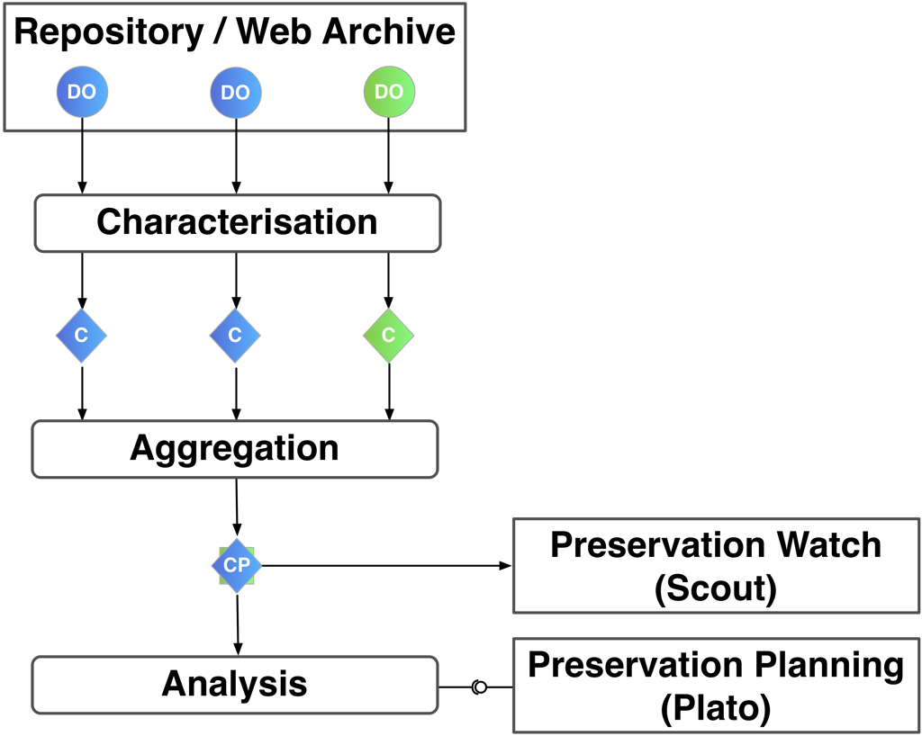
Content Profiling
Global View of Content
  Distribution of characteristics
  Statistics (size, min, max, …)
  Sampling
*
*
- P. Petrov, Content Profiling and Planning, SCAPE Training Event. Guimarães, 2012

Slide 22

Representative Sampling
Based upon metadata
Outliers identification
As few as possible, as many as necessary
Stratification across file type, size, time or any other relevant characteristic for the use case
*
*
- E. Poltorak, Representative sampling, Flickr, http://www.flickr.com/photos/44461316@N08/4110321514/, 2009

Slide 23

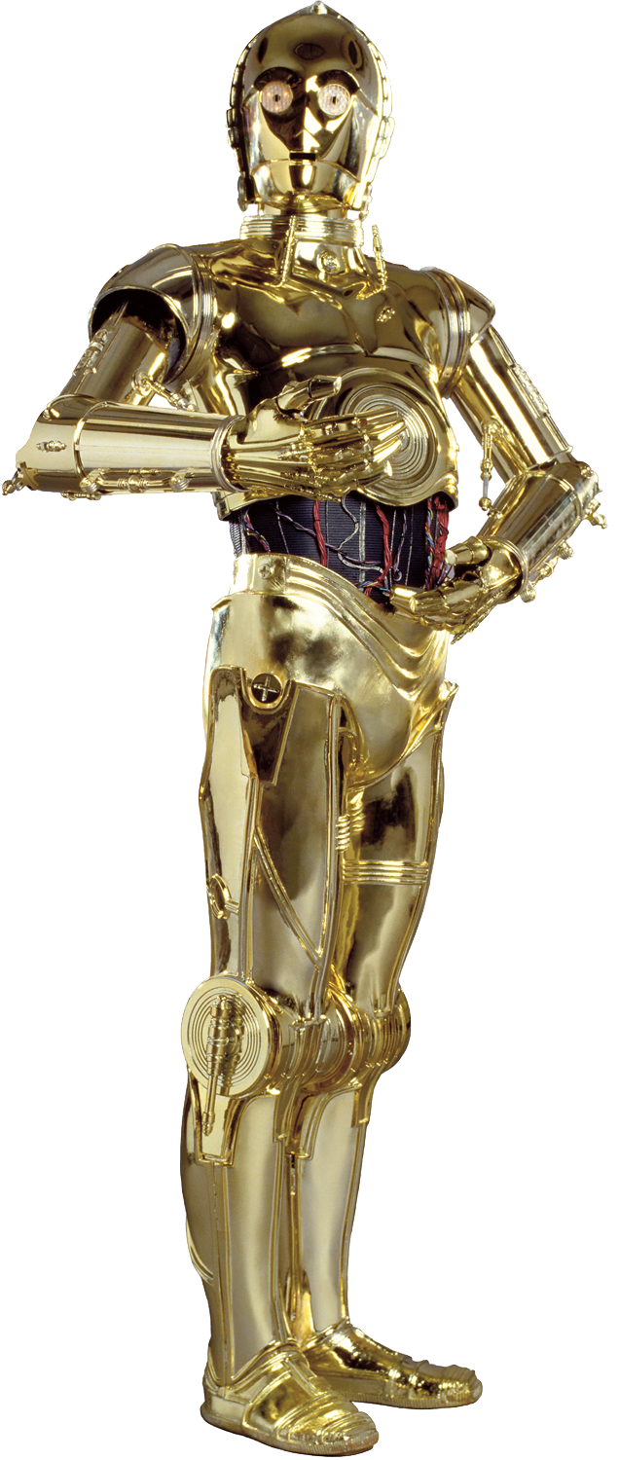
Clever, Crafty Content Profiling of Objects
C3PO is a tool for content profile generation.
Uses characterization results
Deeper content analysis with nice visuals through the web-app
Generates content profiles (map/reduce)
*
Sometimes, I don’t understand human behavior?!
http://github.com/openplanets/c3po
*
- P. Petrov, Content Profiling and Planning, SCAPE Training Event. Guimarães, 2012

Slide 24



Clever, Crafty Content Profiling of Objects
CLI-app
  Parses and processes FITS, Apache Tika files
  Stores data in mongoDB
  Output: XML Profile + CSV
  Support new adaptors
Web-app
  Overview and Browsing
  Filtering
  Representative Sample Set Generation
  REST API (Scout)

Slide 25
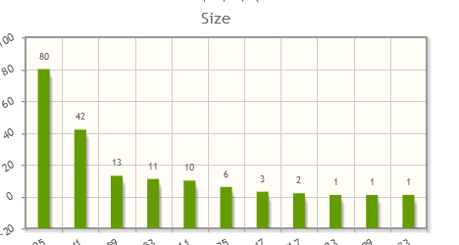
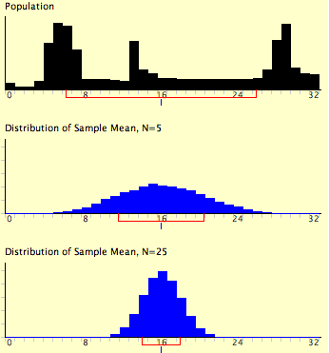
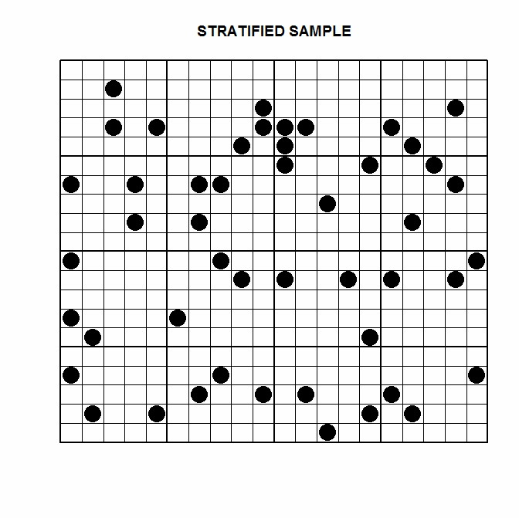
C3PO: Representative Samples
DistSampler
Size'o'Matic 3000
**
*
SysSampler
*
- Statistical Consultants Ltd, http://www.statisticalconsultants.co.nz/weeklyfeatures/WF7.html, 2013
**
- D. Lane, Online Statistics Education, http://onlinestatbook.com/2/sampling_distributions/samp_dist_mean.html, 2013

Slide 26
C3PO: Performance
CPU: 2.3GHz 2-core, RAM: 4GB, HDD.
CLI + Web-app
  Govdocs1
    945699 FITS files
    ingest - 1h 48m
    profile - 12 minutes
    112 different object properties
  Internet Memory Web Archive Data
    958638 FITS files
    ingest - 2h 58m
    profile - 13.5 minutes
    105 different object properties

Slide 27
C3PO: Performance
CPU: 2.3GHz 2-core, RAM: 4GB, HDD.
CLI + noDB adaptor (not publicly available yet)
  SB (Denmark) dataset - 12 TB of data
  563M FITS files
  no ingest
  profile - 49 hours
  5314 different object properties

Slide 28
C3PO: Roadmap
Conflict reduction
  Conflicts of type 2 are solved
Use the PW ontology for an alignment with other tools
  Consistent naming of properties, values, measures
  The ontology will solve conflicts of type 1
Data Connector API
  A common interface to interact with repositories

Slide 29
Summary
Characterization is time consuming
It can be faulty
Know your tools
A tool for content profiling? C3PO!

