Slide 1



Resource Audit and Comparison Tool (ReACT)
Ray Moore (Archaeology Data Service)
and
Andrew Amato (London School of Economics and Political Science)
Overview
The problem
The solution
Benefits/Lesson

Slide 2
Problem
Digital archiving typically involves checking large numbers of digital objects preserved and disseminated in different formats and maintained in discrete file structures and locations.
We needed a simple tool that allowed us to quickly and effectively audit and compare the digital objects in these locations.
For example: The standard OAIS (Open Archival Information System) model in digital preservation data is preserved in three discrete ‘packages’:
  Submission Information Package (SIP) [original]
  Archival Information Package (AIP) [preservation] and
  Dissemination Information Package (DIP) [dissemination]
  Each of which may preserve digital objects in different formats/versions.

Slide 3
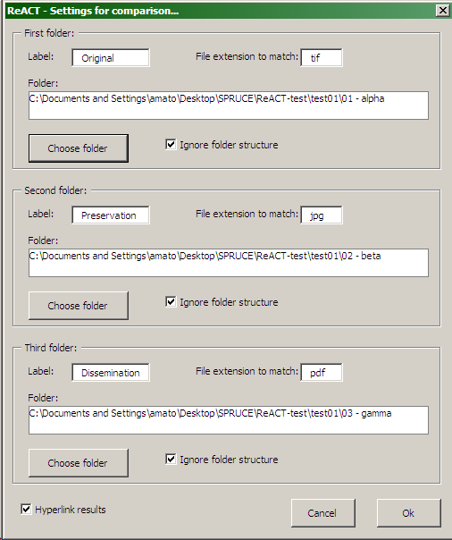
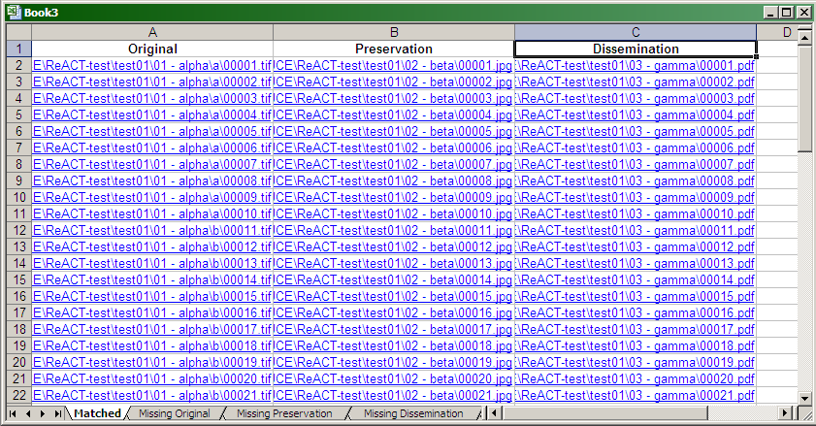
Solution
ReACT uses VBA macros within a Microsoft Excel environment to implement automated comparisons of files across folder and directory structures enacted through a simple GUI.
This produces a simple spreadsheet report which allows the user to quickly and easily see which digital objects have been ‘matched’ from the specified locations and which were ‘missing’ from each location.

Slide 4
Benefits/Lessons
Benefits
The ReACT tool
  Making life a little easier and increasing the efficiency of archiving workflows and provided a solution to a long-standing problem within our (and other) organisation.
Sharing the tool with others
  Suggest its use to clients depositing data with our organisation, but also creating something that can be used by others.
Collaboration
  Facilitates the development of relationships and networks of communication outside our ‘usual’ subject environment.
Lessons
Organisational problems are not simply OUR problems.
  Projects, like SPRUCE, show that there is a wider world out there experiencing the same problems and allows us as a community to address them.
Simple solutions are sometimes the best solutions.
  Tools do not need to be complicated to be useful. Here we used existing software, VBA macro and a GUI to get the results needed.
Developing new tools and methodologies for dealing with problems can be fun and satisfying.

Slide 5
Thanks
Thanks to SPRUCE
and the project partners
Find out more about ReACT
    http://archaeologydataservice.ac.uk/blog/tag/audit/
    http://www.openplanetsfoundation.org/blogs/2012-12-05-resource-audit-and-comparison-tool-react
    The ReACT file and folder audit tool is available via the SPRUCE Repository on GitHub
    https://github.com/openplanets/SPRUCE/tree/master/ReACT

