Slide 1
Digital Collections Audit and Preservation Business Case
Bishopsgate Institute

Slide 2
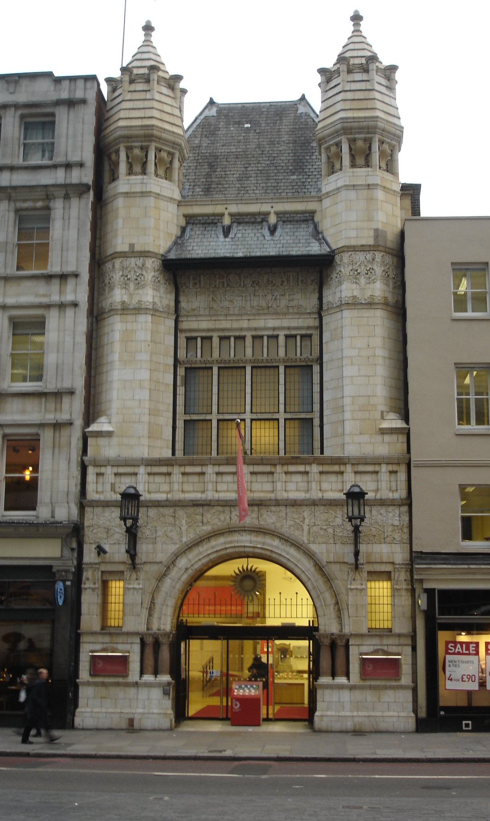
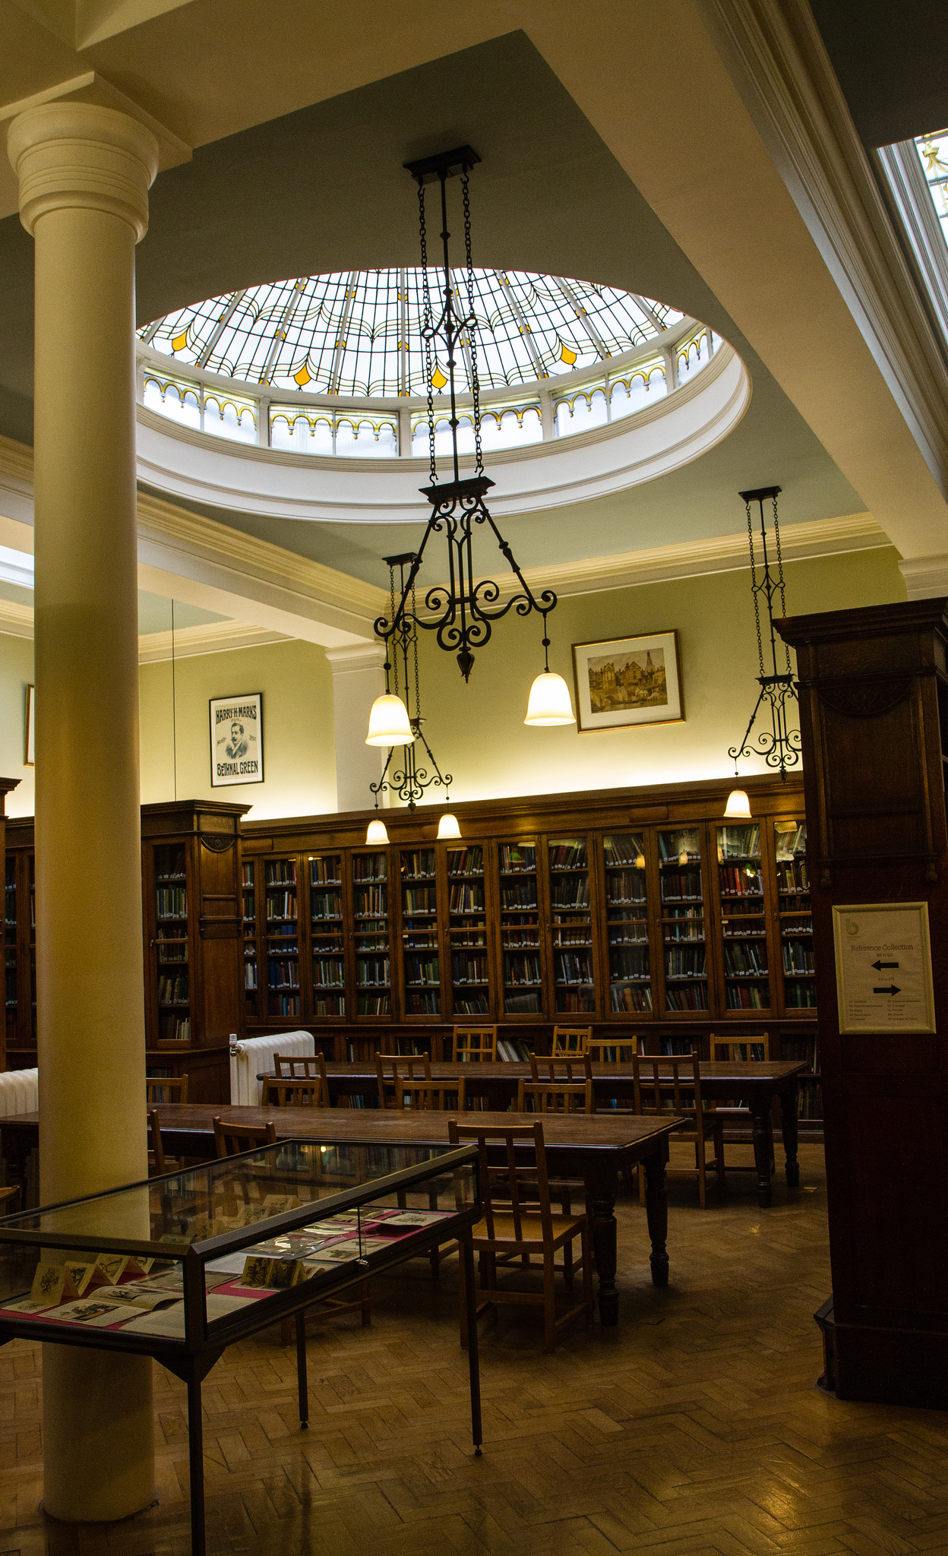

Slide 3
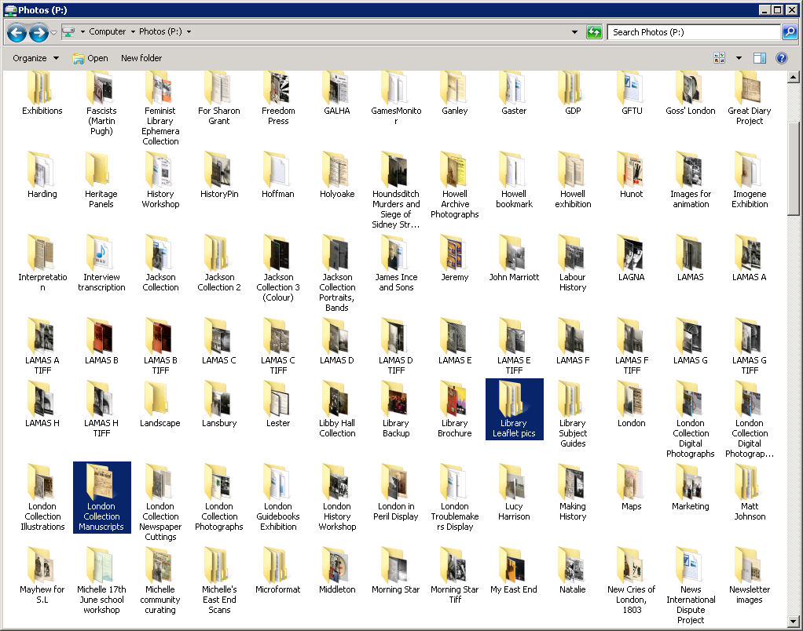

Slide 4

Project Proposal
Collections audit
Business case
Handbook

Slide 5
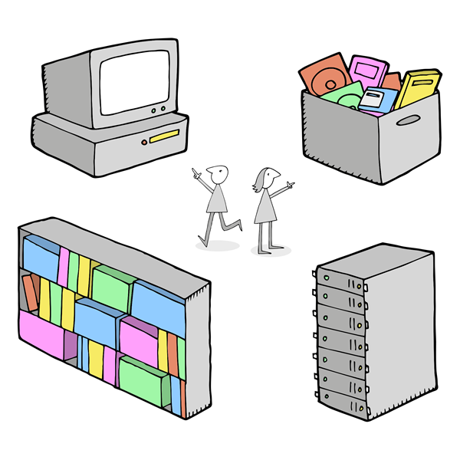
Collections Audit
Tools (FITS, C3PO)
Manual survey
Risk assessment (SPOT, DRAMBORA)

Slide 6
Number of files added to the digital collections by year

Slide 7
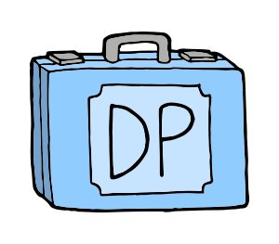
Business Case
Context
Risks
Benefits
Recommendations

Slide 8
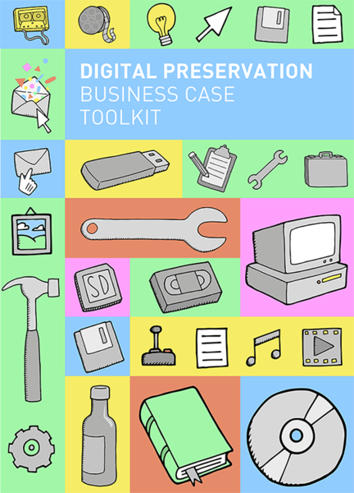
Handbook
wiki.dpconline.org

Slide 9

Lessons Learned
Agile auditing
Focus your business case
Practical preservation

Slide 10

Benefits for Bishopsgate Institute
Digital preservation on the map
Knowledge of our collections
A roadmap for the future

Slide 11

“SPRUCE rocks!”
Illustrations: Tom Woolley
Photographs: Julian Walker, Sally Dunford

