Slide 1

FITS and C3PO enhancements
Paul Wheatley
SPRUCE Project Manager
University of Leeds
@prwheatley

Slide 2
Practitioner needs
What are the main practitioner needs (in terms of supporting tools)?

Slide 3


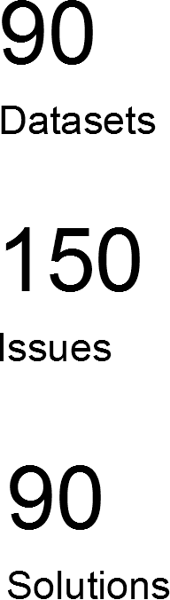
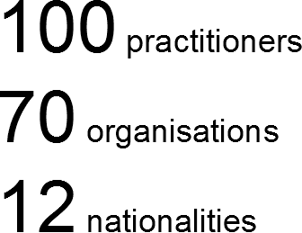
SPRUCE Mashups – the impact
http://bit.ly/spruce-results

Slide 4
Theme 1: Quality Assurance
The problem:
  Some have broken data
  Some have suspected broken data
  Some have an intention to process data in some way, but concerned about lack of ability to check the process doesn't break the data
The solution:
  Cross section of automated QA approaches required.
    How do we spot the flaws automatically?
    How do we fix them automatically?
    Often involves cross checking (eg. Data to metadata)
    Sometimes explorative. What actually caused the problem, how do we prevent it?
    Every case feels unique, but often strikes a chord more widely

Slide 5
Theme 2: Appraisal + Ingest preparation
The problem:
  We have digital stuff, what is it, what should I worry about, what do I do next?
  We know roughly what we've got (we've had some before) but we have a largely manual appraisal process that doesn't scale well
  How do we turn this blob of content into something we can ingest into our repository?
The solution:
  Characterisation capability needs to vastly improve
  Automatic extraction of properties / flavour of content to aid appraisal/selection
  Inform processing of data prior to ingest

Slide 6
Theme 3: Identify/locate preservation worthy data
The problem:
  Institution has preservation worthy data scattered across shared server space
  Data is unmanaged, not check summed, often doesn’t have a responsible owner
  Sorting this data from non-preservation worthy data is a challenge
The solution:
  Find it
    Tools/approaches to “smell” preservation worthy data
  Make it safe
    Check summing, creating manifests, registering basic details with a central authority with preservation responsibility, periodically recalc checksums. All components are there but not in usable package
  Get it ready to ingest
    De-duplication, curation, management, add metadata, other ingest preparation

Slide 7
Theme 4: Conformance to institutional profile/policy
The problem:
  Institution has policy driven requirements for the shape of its content, defined by specific profiles
  Does data conform to these profiles?
  If not (in some cases), can it be made to conform?
The solution:
  Conformance checking focused characterisation and validation
  Modification of content + associated QA

Slide 8
Theme 5: Identify preservation risks
The problem:
  Data is in the repository, what risks does it face?
  Some worry about whether they should be migrating their content
  Some specifically want to format migrate and want help doing it
  Root of problem is: what are the risks?
  Risks themselves not well understood
  Woeful tool provision to assist in automated risk assessment
The solution:
  Tools/approaches for identifying specific preservation risks in digital data
  Logical progression is then for planning, action and QA

Slide 9
Overall challenge - characterisation
Summary of 5 main challenges:
  Quality Assurance
  Appraisal and ingest preparation
  Identify/locate preservation worthy data
  Conformance to profiles/policy
  Identify preservation risks
Conclusion:
  Practitioners need better characterisation capability
  In other words they need better automated ways to understand their data

Slide 10
FITS and C3PO
FITS
  Assess content, identifies characteristics and extracts metadata
C3PO
  Provides a visual interface to navigate and understand the data extracted by FITS
What did we do?
  Update FITS functionality, better coverage, uses latest tools
  Addressed tool maintenance by providing the infrastructure to make the tools community maintainable

