Slide 1
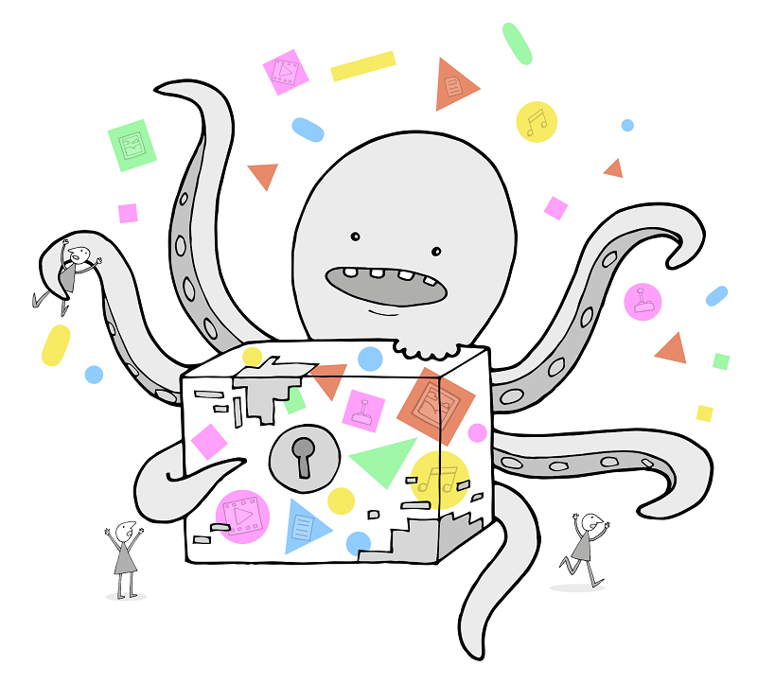
Getting started with hands-on preservation
Paul Wheatley
SPRUCE Project Manager
University of Leeds
@prwheatley

Slide 2
Getting started guides
Audit your digital data
  Create a register of your digital assets
  What, where, who, IPR
Assess your organisation for digital preservation risks
  Understand the context to your assets and what to prioritise
Stabilise a digital collection from handheld media
  Handheld media can degrade
Secure your bits
  Make sufficient copies and put in place the processes to verify their integrity
Assess and understand the characteristics of your digital assets

Slide 3
General principles for getting started in DP
Prompt check in – have you got what you thought you would receive from your supplier?
  Check expected files are present, open a random selection to verify expected quality
  Request replacements from supplier promptly
Create a verifiable manifest
  Create a top down manifest file that lists each digital object in your collection as a relative filename and a checksum
  Library of Congress Bagit specification and tools will also do a good job here
Make at least 3 copies. Protect the bits
  Keep a copy on easily accessible media
  Backup to tape or more disk. Keep copies in different geographical locations to avoid catastrophic disaster. Cloud storage is also an option.
Frequently inspect the condition of your data
  Revisit the collection, recalculate your manifests and verify content has not been lost
  ACE (Audit Control Environment) can help here
  Do a test recovery of your backups that the IT people are doing for you, to ensure they are working effectively!
Record the existence of each of your collections in a digital asset register
  Record: What it is, who is the responsible owner, where it is, who owns it, and who can access it.
Assume nothing, validate everything!
  Double check any processes in the lifecycle that move or alter your digital content
  Built in checks can be flawed, a second opinion is much more trustworthy

