Slide 1

Digital Preservation as a Service
Business Case: Digital Repository
Christopher Fryer: Digital Curator and Assistant Records Manager

Slide 2

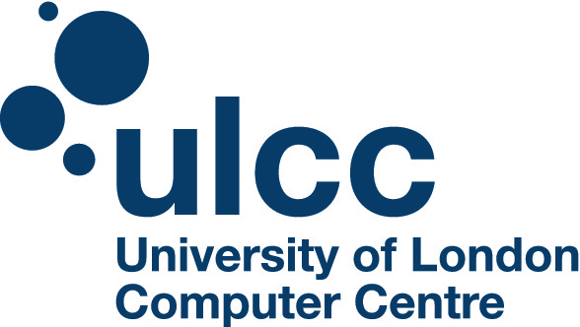

Business Case: Context
Successful funding from SPRUCE/Jisc of £5K for development of digital preservation business case.
Bid included expert consultation from University of London Computer Centre (ULCC).
Views expressed represent current best practice based on expertise and knowledge from Digital Curator and ULCC.

Slide 3

What is a Digital Repository?
A Digital Repository is a combination of people, processes, and technologies which together provide the means to preserve and provide access to digital information.
A Digital Repository does not simply provide backup! It is an active process which anticipates technology and format obsolescence (amongst other things) and resolves these problems before they occur.

Slide 4

Options
Digital preservation is a complex, emerging discipline that is outside the experience of most archivists and requires specialist systems:
    1) Do nothing: Extremely risky and could result in worst case scenario, e.g. permanently losing business critical information
    2) Open Source: Requires lots of investment/expertise (Not feasible)
    3) Out of the Box: Vendors provide best practice systems suitable for NE (Recommended)

Slide 5





Benefits…
Expertise: ULCC provided invaluable input which resulted in best practice outputs.
Momentum: The project provided renewed inputs to assess and solve digital preservation problems.
Profile: External funding from Jisc/SPRUCE enhanced the standing of digital preservation within the organisation.
Awareness: The organisation is now well aware that a new, consistent approach to handling digital data is required.

Slide 6
There’s more…
Risks: Northumberland Estates inability to cope with such digital information risks compromising its core function of functioning as a property management and investment business.
Solutions: Assessed a variety of emerging solutions; from out of the box solutions like Preservica, to open source digital preservation systems such as Archivematica.
Clarity: The project has played a vital role in establishing a clear and sustainable strategy for Northumberland Estates going forwards.

Slide 7


Benefits
(if recommended option is adopted)
Recurring financial savings in supporting the transition from paper based to digital records.
Corporate memory in historical terms, but also the wider context of enhancing accumulated knowledge and expertise.
Increased efficiency and saving of staff time in accessing and disseminating information.
Meeting legislative requirements. There is a very high risk that without proactive intervention, digital information will become inaccessible and Northumberland Estates will be unable to meet its regulatory obligations.
Northumberland Estates have already invested significant resources in the creation of digital information. Adequate digital preservation activities will protect and sustain existing infrastructure.
Supports digital ways of working. For example, the future implementation of an EDRMS can be supported though the assurance that Northumberland Estates can organise and preserve its digital information into the future.

Slide 8

Lessons Learnt
Lack of solutions for small organisations
Much of what is concluded will be based on your own organisational context, all of which can influence the right approach towards digital preservation. However, it is hoped that this project can establish a methodology which other small to medium organisations can adopt.

Slide 9

Lessons Learnt
Identify existing business drivers/organisational goals
Aligning organisational goals from the onset will save you a great deal of work further down the line. By identifying key drivers you can begin to build up support for a recommended solution before the big pitch to senior management.
Lay out the options clearly and concisely
Nail down upfront costs for at least the first three years. Digital preservation cannot be done on the cheap and requires sustained investment and support.

Slide 10



Recap
Requires a long term commitment to invest resources and staff expertise
Recommended option Preservica result of extensive analysis of current market
Risks and future costs will only increase the longer digital preservation is ignored
Have a go! Try the resources under the Northumberland Estates Case Study

