Slide 1
Fund it, Solve it, Keep it
(with SPRUCE)
Toni Sant
Media & Memory Research Initiative
University of Hull @ Scarborough

Slide 2
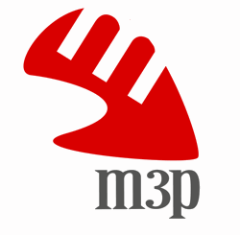
Malta Music Memory Project
A collaborative database of Maltese music
and associated arts
  www.m3p.com.mt
  established in 2010
SPRUCE 2012
Depositing Data from Facebook to MediaWiki
SPRUCE 2013
Establishing a Workflow Model
for Audio CD Preservation

Slide 3

Depositing Data from Facebook to MediaWiki
Brief overview of what we did:
  Reaching out to potential contributors
  Ensuring the appropriate interface for the project
  Develop ways to follow up with interested contributors
  Login through Facebook and pull basic data from your FB user profile to your
  new M3P user profile
  Groundwork for further data
  sharing from FB to MW/M3P

Slide 4
Depositing Data from Facebook to MediaWiki
How we benefitted:
  Direct input from Paddy McCann (DCC)
  PhD project material for Darren Stephens
  Engaged with the UK digital preservation community
  Acquired an open source MediaWiki extension
  / engaged with Wikimedia community

Slide 5
Depositing Data from Facebook to MediaWiki
Top 3 lessons learned:
  Projects work best/easiest when they are
  free-standing
  Small steps make large projects stronger
  Contributors are not just depositors
  (i.e. further work is necessary to create meaningful engagement and exchange)

Slide 6
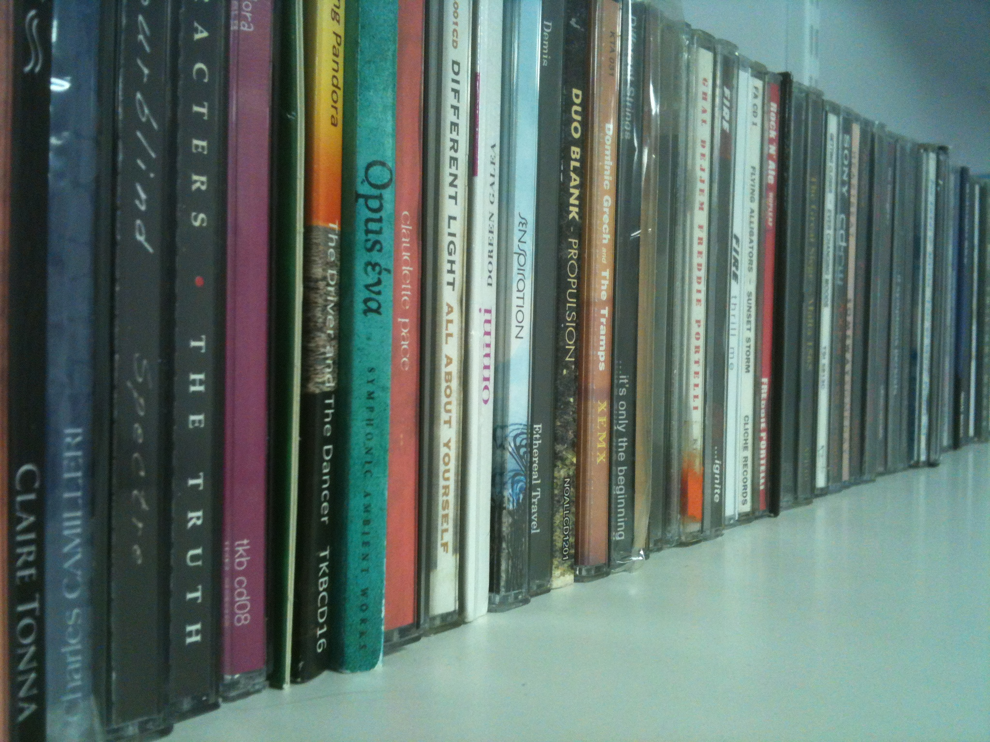
Establishing a Workflow Model for Audio CD Preservation
Brief overview of what we did:
  Create an open source tool for audio CD data preservation, based on cdrdao
  Develop a workflow model for preserving data from audio CDs
  Ensure that the archival materials and the workflow model are built to standards
  Test the tool and workflow
  model on a relatively small
  dataset:
  500 CDs Maltese music

Slide 7
Establishing a Workflow Model for Audio CD Preservation
How we benefitted:
  Direct input from Carl Wilson (OPF)
  Further PhD project material for Darren Stephens
  M3P has a clear project with which to engage its community
  An open preservation tool we can use on GitHub through OPF
  Material for a book chapter in Do It Together, Do it Yourself: Preserving Popular Music Heritage (edited by Sarah Baker)

Slide 8
Establishing a Workflow Model for Audio CD Preservation
Top 3 lessons learned:
  Some things are harder (or more complicated) than first meets the eye
  This project is really on the cutting-edge of preservation attempts in this area
  This work is even more urgent than originally thought due to the scarcity of good quality CD players, especially as we move on into the future

Slide 9
Thank you, SPRUCE! You’ve been good to us…
Email: T.Sant@hull.ac.uk
Twitter: @tonisant
Website: www.hull.ac.uk/mamri

