Slide 1







The SPRUCE
Business Case for
Digital Preservation

Slide 2
Making the case
Initial synthesis of business case templates
Benefits
Costs
Impact/ alignment with strategy/ ROI/ applied benefits/ measures of success
Risks

Slide 3
Making the case
Institutional perspective/alignment
  - What does preservation mean for your institution/context?
Sustainability
  - What are the short- and long-term implications?
Value / audiences
  - Who is affected? What outcomes matter to what audiences?
Costs / skills / approaches
  - What are you proposing? Have you considered various options?
Risks (from failing to preserve / to the solution)
  - Risks related to value. Also risks to what you are proposing.
Ultimately: organisational change – selling a philosophy

Slide 4
Mashup events
Collection owner/practitioner activities
Benefits
Stakeholders
Skills gap analysis
Elevator pitch
http://wiki.opf-labs.org/display/SPR/The+SPRUCE+Business+Case+for+Digital+Preservation (OPF wiki)

Slide 5
Mashup events
Collection owner/practitioner activities
Benefits
Stakeholders
Skills gap analysis
Elevator pitch
http://wiki.opf-labs.org/display/SPR/The+SPRUCE+Business+Case+for+Digital+Preservation (OPF wiki)
Started with KRDS toolkit and example benefits.
Direct/indirect, short/long term, internal/external dimensions.
Good framework, but too theory-heavy for short event format.
Examples very domain-specific (research data)—attendees found some applicability in other contexts but needed interpretation, while others found it easier to start from generic/first principles.
Institutional-alignment strengthened by asking attendees to bring strategy/policy documents from their own institutions and linking benefits to explicit local principles, objectives, and priorities.

Slide 6
Mashup events
Collection owner/practitioner activities
Benefits
Stakeholders
Skills gap analysis
Elevator pitch
http://wiki.opf-labs.org/display/SPR/The+SPRUCE+Business+Case+for+Digital+Preservation (OPF wiki)
Generic / high-level benefit | Detailed description | Aligns with institutional objective

Slide 7
Mashup events
Collection owner/practitioner activities
Benefits
Stakeholders
Skills gap analysis
Elevator pitch
http://wiki.opf-labs.org/display/SPR/The+SPRUCE+Business+Case+for+Digital+Preservation (OPF wiki)
Who is involved (in the case and the solution)? Who benefits?
Multiple levels (senior managers, operational managers, practitioners and experts, non-specialists and other colleagues)
Multiple audiences (library IT, finance, academics/users, depositors – specialists and non-specialists, technical and not)
How to express benefits? What language to use?
What is realistic (large cash budget/procurement? staff posts?)
What are the necessary components of a case in each context?

Slide 8
Mashup events
Collection owner/practitioner activities
Benefits
Stakeholders
Skills gap analysis
Elevator pitch
http://wiki.opf-labs.org/display/SPR/The+SPRUCE+Business+Case+for+Digital+Preservation (OPF wiki)
Stakeholder* | Interest/stake
Library director
Archive manager
Liaison Librarian
Finance director
Head of IT
(etc.)
* stakeholders are specific to your context

Slide 9
Mashup events
Collection owner/practitioner activities
Benefits
Stakeholders
Skills gap analysis
Elevator pitch
http://wiki.opf-labs.org/display/SPR/The+SPRUCE+Business+Case+for+Digital+Preservation (OPF wiki)
 | Interest (low) | Interest (high)
Power / importance (low) | Monitor ... | Keep informed ...
Power / importance (high) | Keep satisfied ... | Manage closely ...

Slide 10
Mashup events
Collection owner/practitioner activities
Benefits
Stakeholders
Skills gap analysis
Elevator pitch
http://wiki.opf-labs.org/display/SPR/The+SPRUCE+Business+Case+for+Digital+Preservation (OPF wiki)
Activity (description) | Role (job title)
Skills (y/n/training) | Resource (y/n/%)
Notes:
Skills as a proxy for costs and institutional readiness

Slide 11
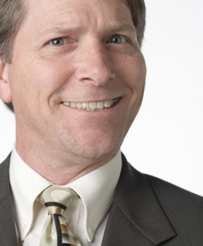
Mashup events
Collection owner/practitioner activities
Benefits
Stakeholders
Skills gap analysis
Elevator pitch
http://wiki.opf-labs.org/display/SPR/The+SPRUCE+Business+Case+for+Digital+Preservation (OPF wiki)
(would scary management guy buy a preservation solution from YOU?)

Slide 12
Mashup events
Collection owner/practitioner activities
Benefits
Stakeholders
Skills gap analysis
Elevator pitch
http://wiki.opf-labs.org/display/SPR/The+SPRUCE+Business+Case+for+Digital+Preservation (OPF wiki)
Drawing separate components together.
Developing a flow.
Distilling your argument.
Practising delivery and preparedness.*
* NB SPRUCE does not recommend guerrilla warfare with senior managers

Slide 13
Mashup events
Collection owner/practitioner activities
Benefits
Stakeholders
Skills gap analysis
Elevator pitch
http://wiki.opf-labs.org/display/SPR/The+SPRUCE+Business+Case+for+Digital+Preservation (OPF wiki)
SPRUCE has produced a large evidence base,
rough notes for benchmarking/comparator analysis
Archaeology Data Service, Bodleian Libraries, National Library of Scotland, Public Record Office of Northern Ireland, National Fairground Archive, University of St. Andrews, Centre for Children’s Books, McClean Museum, Binghamtom University, Bishopsgate Institute, Science and Technology Facilities Council, Birmingham Archives, Goldsmiths, University of Central Lancashire, Dorset History Centre, Lloyds Banking Group, Lovebytes, National Media Museum, National Motor Museum, Northumberland Estates, Tate, Royal Institute, Middlesex University, British Library, Historic Royal Palaces, University of Hull, Institute of Education

Slide 14
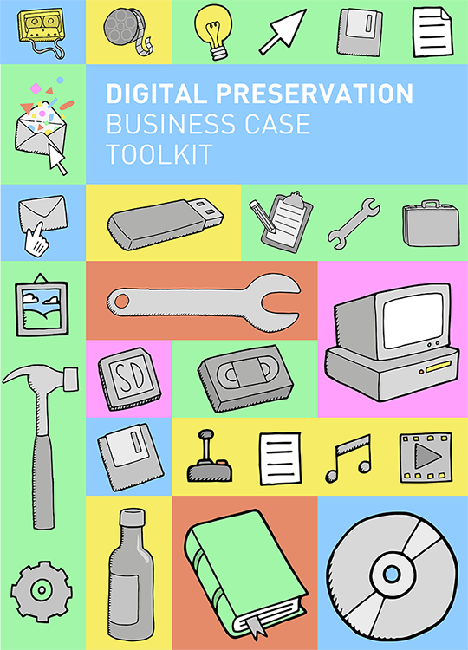
Business Case Toolkit
Brought to you by:
  3 days...
  13 authors...
  1 wiki...
  Lots of coffee / beer / confusion / laughter...
  A digital preservation version of top trumps...
http://wiki.dpconline.org/

Slide 15
Business Case Toolkit
About
Step-by-step
Template
FAQ
Case studies
Additional resources
http://wiki.dpconline.org/

Slide 16
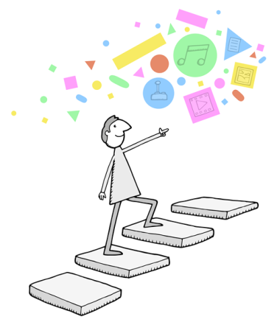
Step-by-step (by step... by step...)
prepare yourself! → audit
readiness → assess where
you are and what you need
→ think about your audience → work out your objectives → benefits + alignment → sort your documentation → validate and refine → deliver with impact (politics...)
→ share for make great community learning!
(to a digital wonderland...)

Slide 17

Template
(clipboards make you look like you know what you’re talking about...)
Executive summary
Strategic vision
  Where is this going? How long will it take?
Background, context, and status
  Environment, state of the collection(s), institutional readiness, stakeholders, preservation risks
Business activity
  What are you proposing? What are the options?
Options/value for money/ROI
  Benefits, costs, implementation risks

Slide 18

When? Why? What?
Who? How?
(16,842 KM from somewhere you’ve never been...)
In an FAQ-style...
When is the right time?
Why are we doing this?
What resources are we focusing on?
Who is going to be affected?
How do I make the case?

Slide 19

Case studies
Bishopsgate Institute
  collections audit + ‘first steps’
Institute of Education
  administrative record keeping
Northumberland Estates
  open-source/hybrid/commercial assessment + procurement
Lovebytes
  digital art archive, partnerships and funding
University of St. Andrews
  research computing service, new staff posts
(not the study of briefcases...)

Slide 20

Additional resources
References to other community sources
Minnesota Historical Society, Center for Technology
in Government, Tessella webinar/value toolkit
The Atlas of Digital Damages
Digital preservation illustrations licensed under creative commons
guidance from common practitioner challenges at SPRUCE mashups
over to you (the community)...
Risk analysis (SPOT, DRAMBORA, DPC getting started)
Institutional readiness (AIDA, TRAC, NDSA levels)
Benefits (Balanced Value, KRDS, eSpida, Grindley’s funnel)
Scenario planning and costs (HE archive, local gov, doing nothing)

Slide 21
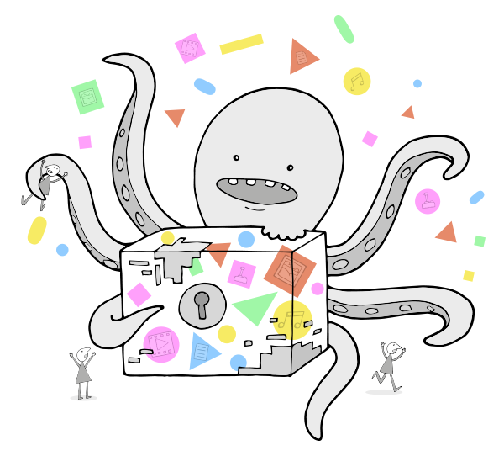
Final thoughts
It’s about relevance to local objectives.
Making the case is incremental and about continuous improvement.
Demonstrate value, use results to make case for further investment.
Don’t attempt a ‘final solution’ in one go. This often fails.
Be realistic. Acknowledge challenges, show how these will be addressed through the work you are proposing.
Make use of and contribute learning to the community!

