Slide 1
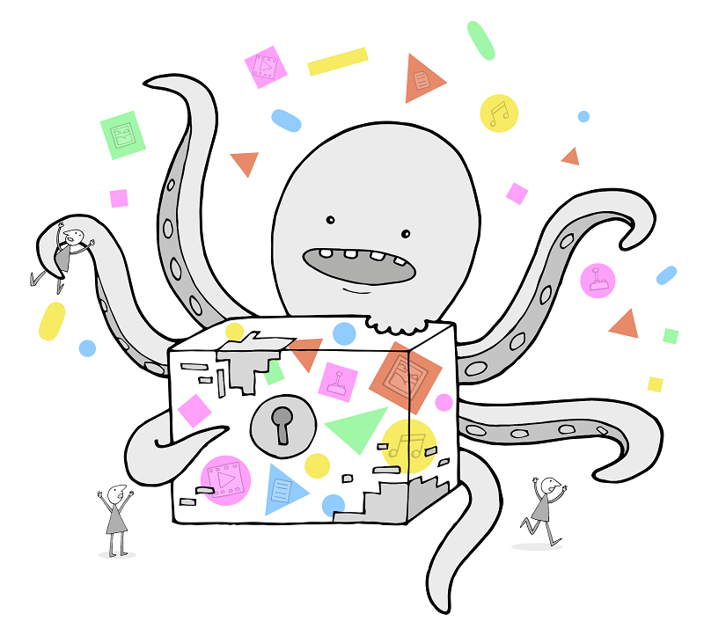
Supporting preservation:
an introduction to SPRUCE
Paul Wheatley
SPRUCE Project Manager
University of Leeds
@prwheatley

Slide 2
How do I find x, y or z?
http://bit.ly/spruce-project
All presentation slides
Detailed run down on the most useful SPRUCE outputs
I’ll email you a reminder next week

Slide 3
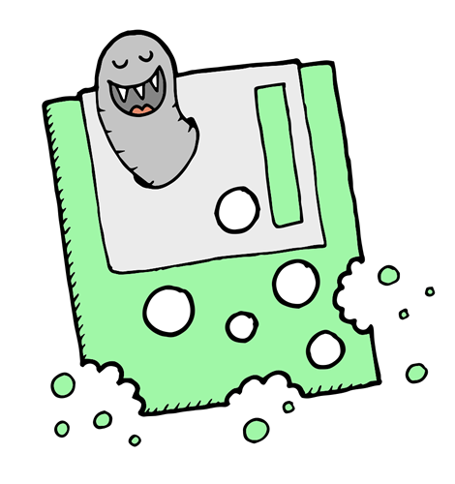
Some of the things I’m going to talk about
How we developed the SPRUCE approach
Supporting DP with face to face events
SPRUCE Awards
Online collaboration
Sustainability and the business case for digital preservation

Slide 4

SPRUCE Origins
Encountering “real” digital preservation challenges
Existing community solutions not meeting needs of practitioners
Lots out there, beyond our community, that could help
Jisc funded AQuA project
Ran two face to face events
Led to the creation of a successful event format for solving preservation challenges – SPRUCE Mashups

Slide 5






The default “about this project” slide...
SPRUCE: Sustainable Preservation Using Community Engagement
Funded by Jisc
Ends November 2013
Aim: to kick start, support and sustain digital preservation activity via a community approach
http://bit.ly/spruce-project

Slide 6
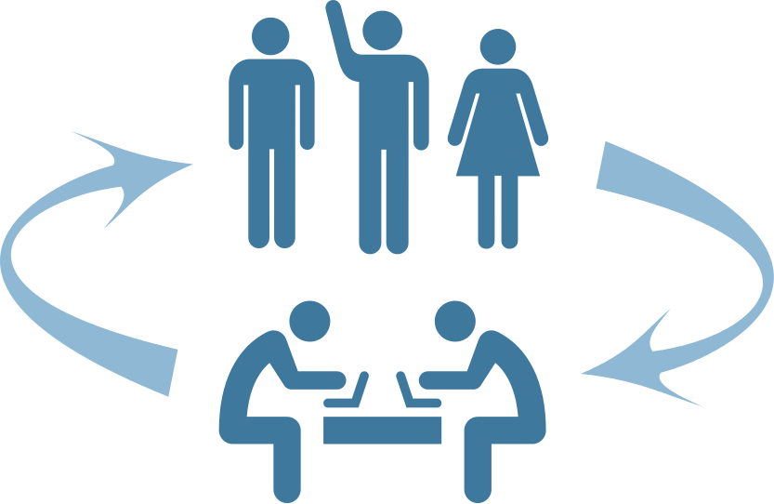
Essential components of the SPRUCE approach
Having the right mix of expertise and understanding
  Users / practitioners: understand the data and the challenge
  DP experts and techies: understand the approaches and the tools
Awareness of what’s out there
  Approaches
  Software tools
A willingness to openly share
  Needs/Requirements
  Sample data
  Results, good or bad
Engage with the wider community
users/practitioners/
problem owners
developers/techies/DP experts
hackers/solution providers

Slide 7
Channel this thought...
“Sharing best practice?
We don’t even share practice!”
Andrew N. Jackson, Web Archiving Technical Lead, The British Library
Curate Camp, Toronto, 2nd October 2012

Slide 8



Crude maturity model for DP
TM
Evidence
Best Practice
Standards

Slide 9
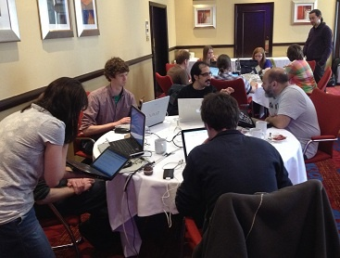
SPRUCE Mashup: A journey in 3 days flat
30 people, 1 room, 3 days
Data->Issue->Solution->Understanding
Glasgow Mashup
April 2012

Slide 10
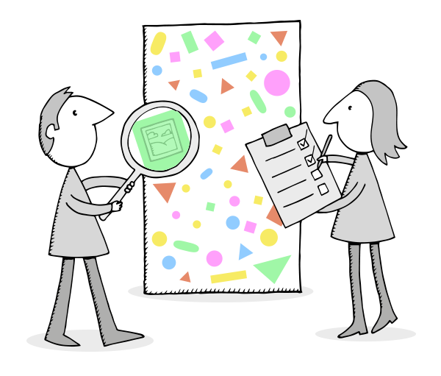
DP collaboration via face to face events: Mashups
3 SPRUCE Mashups
  3 day, agile workshops
  Practitioners bring data
  Developers work with them
  Solve concrete DP challenges
  Business case exercises
Characterisation Hackathon
  Representatives from:
  JHOVE, JHOVE2, DROID, FIDO, C3PO and FITS
  Tika->FITS+C3PO, FF magic, PDF risk
  More on mashups: http://bit.ly/spruce-mashup

Slide 11


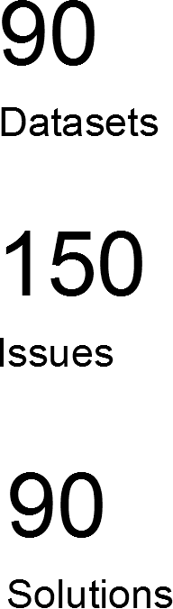
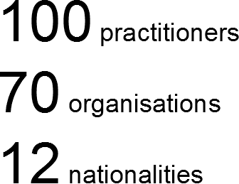
SPRUCE Mashups – the impact
http://bit.ly/spruce-results

Slide 12

SPRUCE Awards
Follow up funding awards
  £60k distributed in £5k awards
  Short projects building on preservation or business case work from mashups (eligible to event attendees only)
  Final five projects have just been completed
Project themes:
  User led preservation tool enhancement
  Digital preservation kick starts
  Audits and business cases for further funding
  Media imaging and data stabilisation

Slide 13
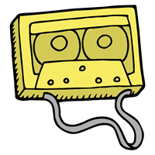


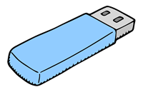
The awards
Institute of Education: A review of approach and generation of a business case for digital administrative record keeping
Archaeology Data Service: Resource Audit and Comparison Tool (ReACT)
Malta Music Project at University of Hull: Depositing Data from Facebook to MediaWiki
Bishopsgate Institute Library: Digital Collections Audit and Preservation Business Case
BEAM at Bodeleian Libraries: Sprucing up the TikaFileIdentifier
Gary McGath: FITS Enhancements
Creative Pragmatics: C3PO Community Ready
Northumberland Estates: Preservation as a Service - Repository Business Case (due for completion November 2013)
University of Hull: Establishing a Workflow Model for Audio CD Preservation (due for completion November 2013)
Lovebytes: Lovebytes Media Archive Project (due for completion November 2013)
University of Nottingham: Metadata for Preservation (due for completion November 2013)
FITS Blitz: Making FITS community sustainable
  http://bit.ly/spruce-awards

Slide 14
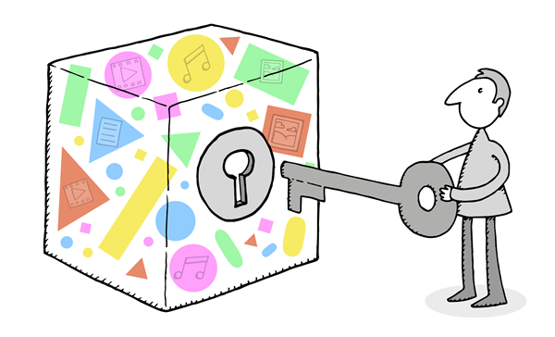
Online Approaches to Collaboration
Three key aims:
  Develop the community – get people working together more effectively and increase awareness of others skills and others work that can be exploited
  Develop some shared DP resources
  Tackle some key “collaboration fails”
Experimental...
  Explore and learn the lessons
All are collaborations in themselves, not necessarily “SPRUCE” initiatives
http://bit.ly/spr-collaborate

Slide 15
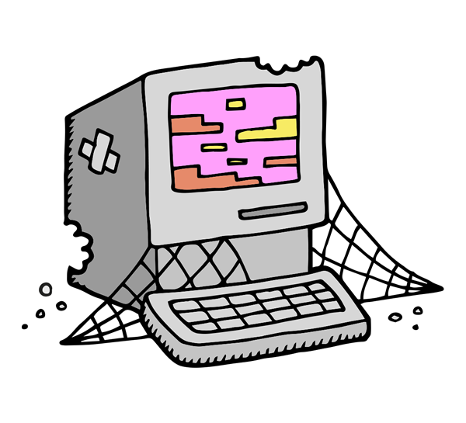
The initiatives
Atlas of digital damages
Q&A site for digital preservation
File format information
  http://fileformats.archiveteam.org/
  CRISP
Datasets, Issues and Solutions
Format Corpus
Online collaborative events:
  #fileidhack: 24 hour file format id hackathon
  AV CurateCamp
COPTR

Slide 16
Finding tools: profusion of registries/lists
﻿The OPF Tool Registry: Embyonic OPF wiki registry of digital preservation tools, uses tagging to make browsing easy, and references experiences of using the tools where available
﻿AQuA Mashup Tool List: Flat list of tools that were mentioned during the AQuA Project mashups (some of this has been migrated to the Registry, above)
AJ Tool Registry: Andy Jackson's Delicious bookmarks of other tool lists.
Digitial Curation Centre catalogue of Tools and Services: Tool list categorised by function and user. Has some quite detailed descriptions of the tools.
Some Forensics Tools: Blog post from the DPC event on digital forensics, listing all the tools that were mentioned during the event.
Digital Curation Exchange Tool list : A lengthy but flat list of digital curation tools
Agogified Digital Preservation Tools and Services: Short list of well known DP community sourced tools from Bill LeFurgy
LoC Supported Digital Preservation Tools: Also see this short blog post listing a handful of Library of Congress supported tools and initiatives
Gary McGath's list of software for extracting file format information
Just Solve Software
Lots of software links and lists on various parts of the Forensics Wiki including for example File format ID
PADI list of tools and papers about tool initiatives: Quite an old list from the now defunct PADI site that has been archived in Pandora
Gloucestershire Archives tool list: short list of community tools, several are wrapped by their alpha workbench software
Report from CARLI Digital Preservation Conference: tools and services that were discussed. Some interesting web services covered.
Fileformat info's tools for dealing with file formats ...........

Slide 17
COPTR
Community Owned digital Preservation Tool Registry (COPTR)
Create a new tool registry in a neutral location
Engage organisations
Collate and combine tool entries from existing registries
Expose a data feed
Close down the source registries
Drive forward community buy in and maintenance

Slide 18
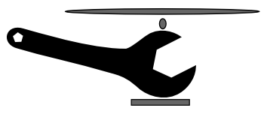
COPTR: An ANADP and SPRUCE initiative
http://coptr.digipres.org
Beta launch was on Monday!
Collaboration between these organisations:
  The Open Planets Foundation (OPF)
  The National Digital Stewardship Alliance (NDSA)
  The Digital Curation Centre (DCC)
  The Digital Curation Exchange (DCE)
  The Preserving Objects With Restricted Resources (POWRR)

Slide 19
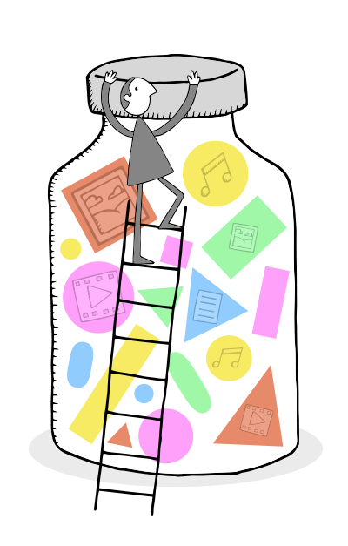
COPTR solve a challenge, demo an approach
Considerable impact at #ANADPII (Aligning National Approaches to Digital Preservation)
Potential to apply this approach in other areas
Home grown Q&A site at the same neutral URL, with many DP groups already engaged to contribute

Slide 20
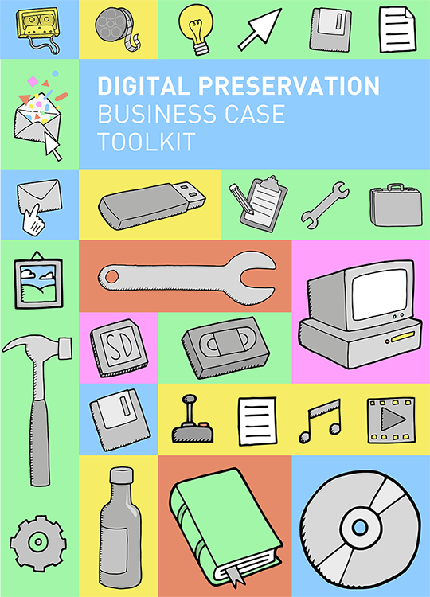
Digital Preservation Business Case Toolkit
http://wiki.dpconline.org

Slide 21


Questions?
Thanks to the SPRUCE Team:
Bo Middleton, University of Leeds
William Kilbride, Digital Preservation Coalition
Maureen Pennock, British Library
Bram van der Werf, Open Planets Foundation
Ed Fay, London School of Economics
Jodie Double, University of Leeds
Carl Wilson, Open Planets Foundation
Becky McGuiness, Open Planets Foundation
Beccy Shipman, University of Leeds
and
Andy Jackson, British Library
Paul Wheatley
SPRUCE Project Manager
University of Leeds
@prwheatley
Cartoon illustrations are by Tom Woolley and are available for re-use under a CC-BY-NC license as part of the:
Digital Preservation Business Case Toolkit http://wiki.dpconline.org/

