Slide 1
SCAPE
Scalable Preservation Environments

Slide 2
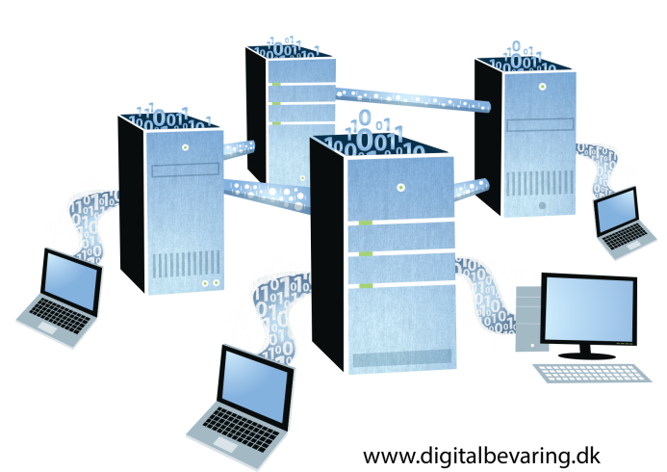
What is SCAPE?
Its all about scalability!
Scalable services for planning and execution of institutional preservation strategies.
Infrastructure for the execution of digital preservation processes on large volumes of data.
Existing tools have been improved and extended.
New tools have been developed where necessary.

Slide 3
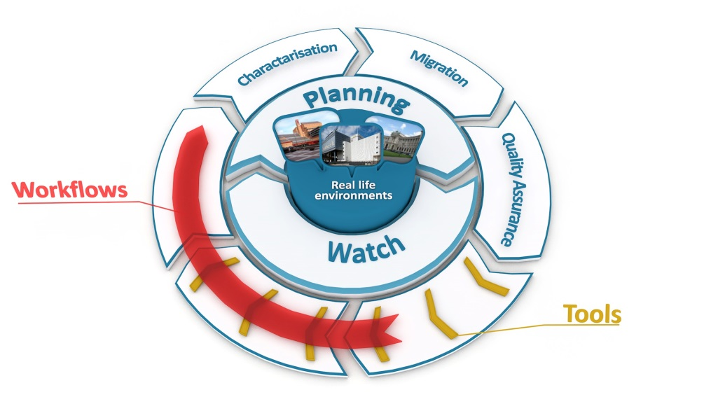
What is SCAPE?
SCAPE covers the whole digital preservation life cycle
Interconnecting services support the preservation of large repositories of digital objects
Applications support the formulation of preservation policies, decision making and selection of preservation action

Slide 4
What is SCAPE?
Take your pick – choose what you need!
Use the full set of interconnected SCAPE components or a selected series of SCAPE tools or workflows
Many SCAPE components can be individually incorporated

Slide 5

Solutions Tested in Real Life
All SCAPE solutions origine from real-world challenges at the partner institutions.
Each challenge is tested in testbeds at the partner institutions.
Web Content
Digital Repositories
Data Centres
Research Data Sets
Testbeds

Slide 6
Solutions for Content Holders
Scalability
In four dimensions: Heterogeneity of collections as well as number, size and complexity of objects
Automation
Through scalable, automated and simple to design preservation workflows
Planning
Answering core preservation planning questions
Integration
Through a robust, integrated, open source preservation system

Slide 7
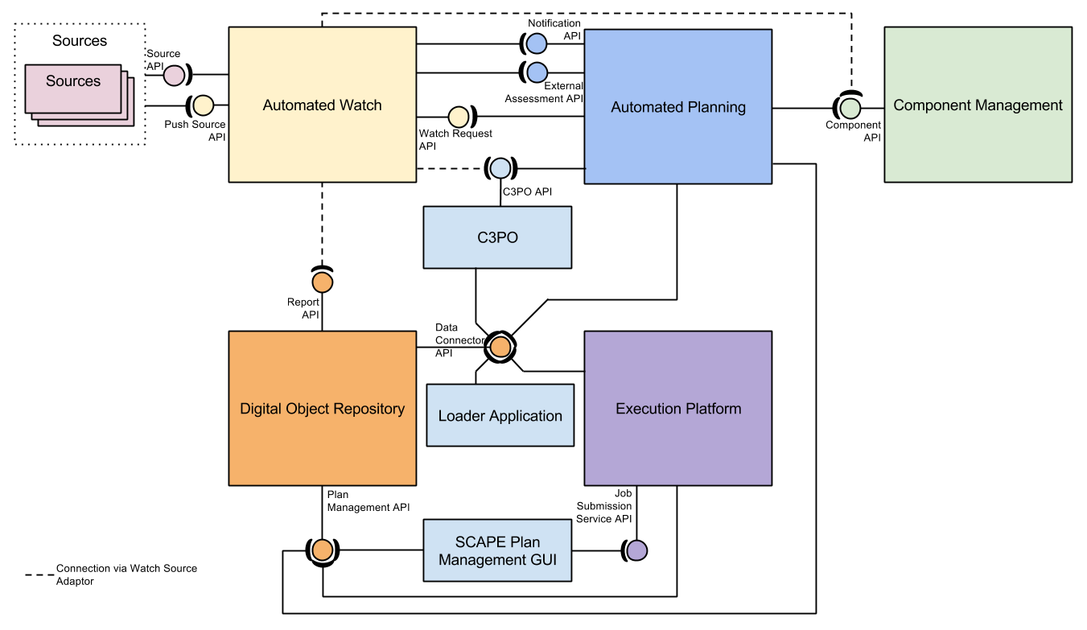
Overview: SCAPE Architecture

Slide 8
Additional Sources of Interest
Development Infrastructure
  Code repository hosted by the Open Planets Foundation and GitHub
    https://github.com/openplanets/scape/
  Development Wiki
    http://wiki.opf-labs.org/display/SP/Home
Tools
  http://www.scape-project.eu/tools
Experimental Workflows
  http://www.myexperiment.org/search?query=SCAPE&type=all&commit=Search
Publications
  http://www.scape-project.eu/category/publication
Public Deliverables
  http://www.scape-project.eu/category/deliverable

Slide 9


Sustainability of Tools and Services
SCAPE tools are published as open source software.
Tools and services from SCAPE are sustained by
Open Planets Foundation -
address core digital preservation
challenges and engage with the community
COPTR -
Community Owned digital Preservation
Tool Registry

Slide 10

About SCAPE
EU-funded project under FP7 (Research and Technological Development)
Project runtime: February 2011 to September 2014
20 partners from 10 countries - from memory institutions, data centres, research labs, universities, and industrial firms
Public Project materials are licensed under a
CC-BY-SA International License

Slide 11



















SCAPE Consortium
11

Slide 12

More Information
SCAPE website: www.scape-project.eu
Blog posts and more:
www.openplanetsfoundation.com/projects/scape
Tools and Services: https://github.com/openplanets/scape
SCAPE Twitter: @SCAPEProject, #SCAPEProject
SCAPE Newsletter: Sign up via www.scape-project.eu
All images © the SCAPE Project or its partners,
except images on slides 3, 6 and 26 © www.digitalbevaring.dk

