Slide 1
SCAPE
Scalable Preservation Environments
Per Møldrup-Dalum
State and University Library
SCAPE Information Day
State and University Library, Denmark, 2014-06-25

Slide 2
Agenda
What is SCAPE?
What can it offer?
Who are involved in SCAPE?

Slide 3
Digital Preservation – What do I need?
Your collection of digital data is growing rapidly.
Your preservation activities must become more efficient and more scalable.
The SCAPE project has developed scalable solutions for long-term preservation of large-scale and heterogeneous data sets.

Slide 4
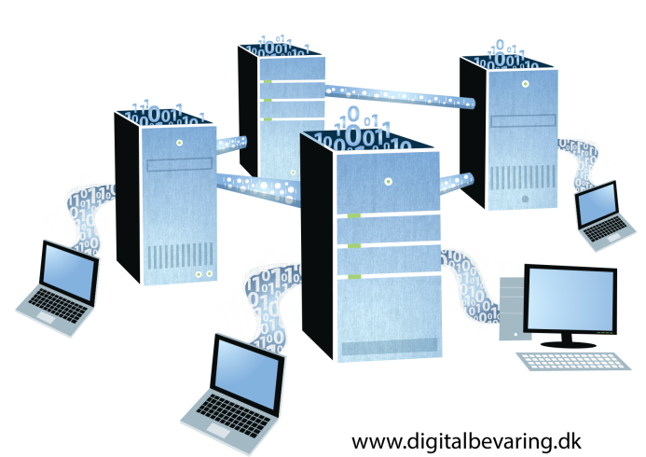
Scalability — 4 dimensions
Heterogeneity of collections
Size of objects
Number of objects
Complexity of objects
Notes:
Scalable services for planning and execution of institutional preservation strategies
Infrastructure for the execution of digital preservation processes on large volumes of data
Existing tools have been improved and extended.
New tools have been developed where necessary.

Slide 5
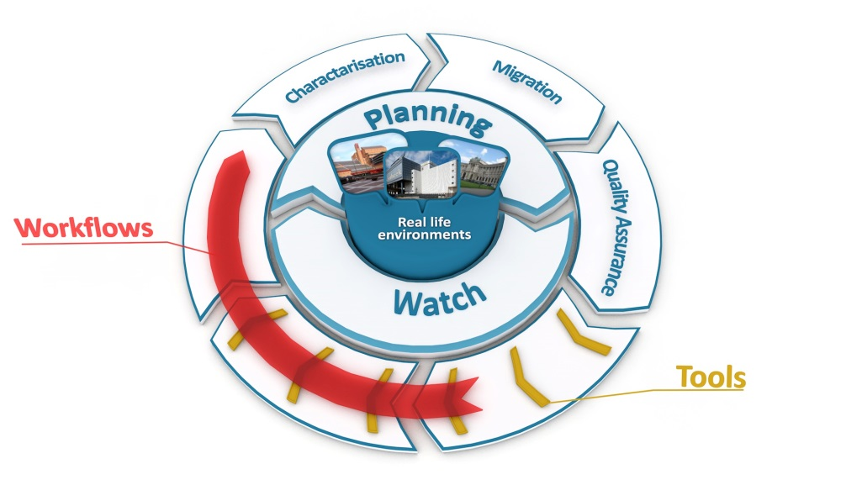
What is SCAPE?
Notes:
The BIG picture. We are not quite there yet
Interconnecting services support the preservation of large repositories of digital objects.
Preservation Policies -> execution of Preservation Plans
Applications support the formulation of preservation policies, decision making and selection of preservation action.

Slide 6
Solutions Tested in Real Life
Web Content
Digital Repositories
Data Centres
Research Data Sets

Slide 7
Solutions for Content Holders
Scalability
In four dimensions: Heterogeneity of collections as well as number, size and complexity of objects
Automation
Through scalable, automated and simple to design preservation workflows
Planning
Answering core preservation planning questions
Integration
Through a robust, integrated, open source preservation system
Centralised services
Allowing content holders to share information globalising the basis for decision-making

Slide 8
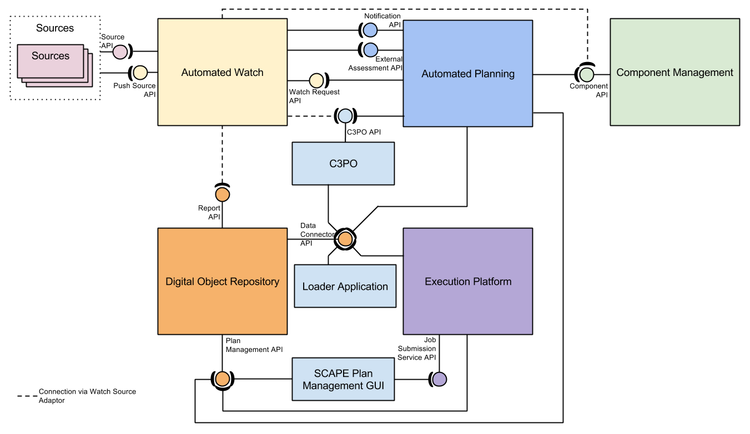
Overview: SCAPE Architecture

Slide 9
Overview: SCAPE Components
The SCAPE Platform is a reference architecture for scalable preservation environments

Slide 10
Overview: SCAPE Components
The SCAPE Preservation Components are tools which enhance the functionality of a digital preservation system in:
Scalability
Functional coverage
Quality

Slide 11
Overview: SCAPE Components
The SCAPE Planning and Watch components address the bottleneck of decision processes and processing information required for decision making

Slide 12
Examples of tools and services

Slide 13
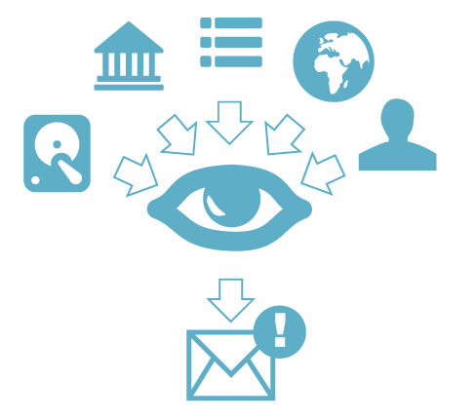
Scalable Planning and Watch
Scout – an Automated Preservation Watch System
Enables you to monitor your collections
Lets you access
community knowledge
Collects relevant knowledge and enables automated notification

Slide 14
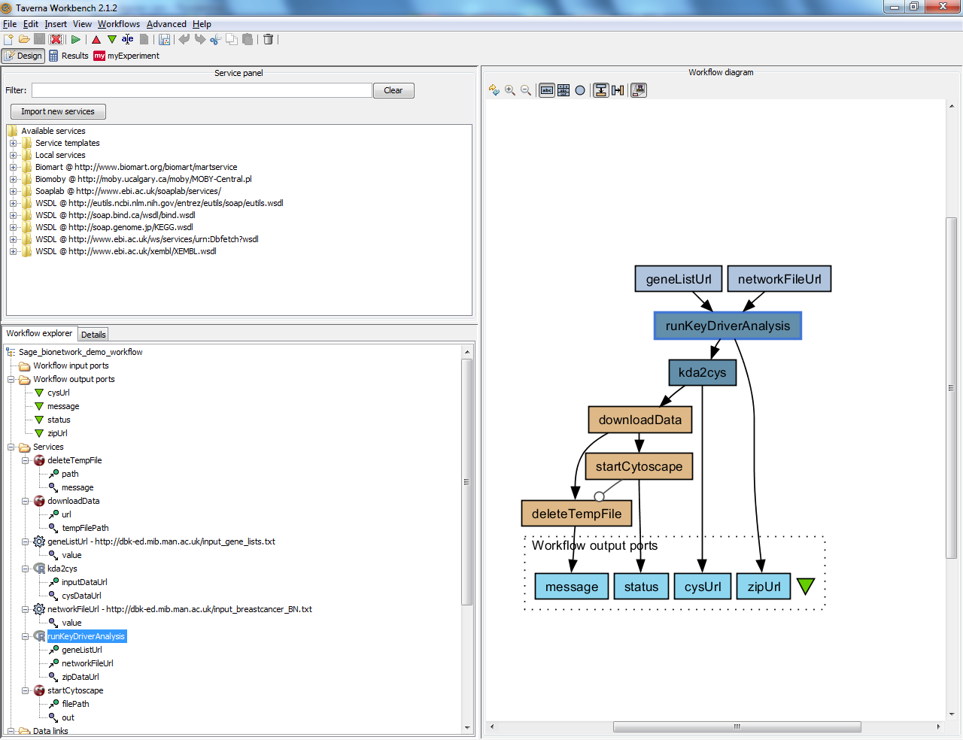
Taverna Workbench
Desktop application
GUI
Plug-in Framework
Themed editions
Intermediate results views
Search for Web Services in catalogues
Search and publish to myExperiment
Taverna Server

Slide 15
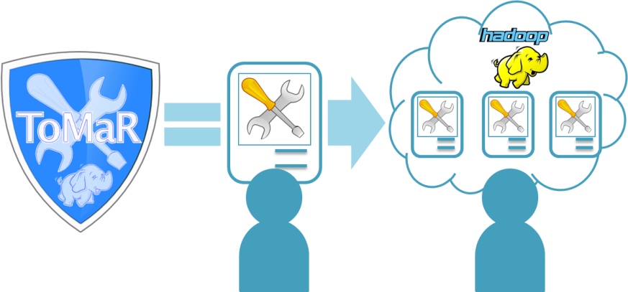
Scalable Tools
ToMaR – let your Preservation Tools Scale
Run existing tools against large amounts of files
Execute tools in a scalable fashion on a MapReduce cluster
Enable scalable workflows which chain together a set of tools
Process payloads too big to be computed on a single machine

Slide 16
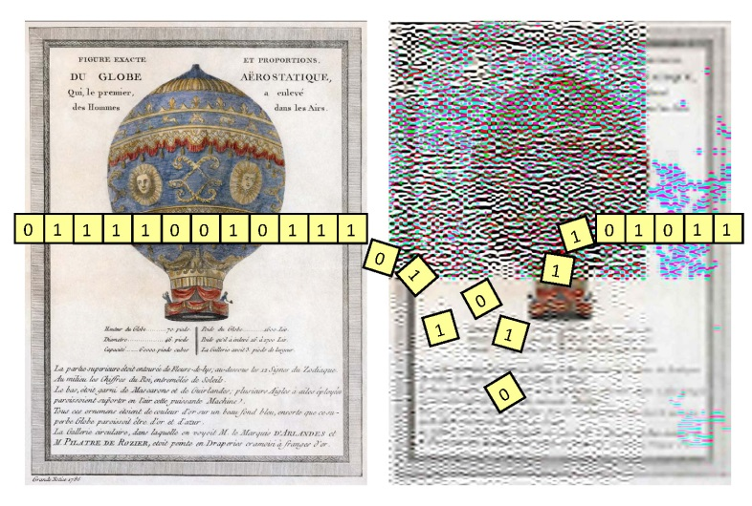
Preservation Components
Jpylyzer – Easy Validation of JPEG 2000
Automated JP2 validation and feature extraction
Enables you to confirm whether an image is a valid, intact JP2 file
Reports the key technical properties of the image

Slide 17
Preservation Components
xcorrSound – Automate Sound Wave Analysis
Compare two audio files and output the similarity
Detect overlaps in audio files
Detect occurrences of a smaller audio file (e.g. a jingle) within a larger audio file or an index of audio files

Slide 18

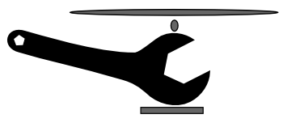
Sustainability of Tools and Services
SCAPE tools are published as open source software.
Tools and services from SCAPE are sustained by
Open Planets Foundation -
address core digital preservation
challenges and engage with the community
COPTR -
Community Owned digital Preservation
Tool Registry

Slide 19
Sustainability of SCAPE results
Ultimate Sustainability goal:
Supporting communities of practice by enabling efficient collaboration during the project and beyond.
Open Planets Foundation will take post-project ownership of the outputs, supported by other partners providing specific capabilities.

Slide 20

About SCAPE
EU-funded project under FP7 (Research and Technological Development)
Project runtime: February 2011 to September 2014
20 partners from 10 countries - from memory institutions, data centers, research labs, universities, and industrial firms
Public Project materials are licensed under a
CC-BY-SA International License

Slide 21



















SCAPE Consortium
21

Slide 22
Additional Sources of Interest
Development Infrastructure
  Code repository hosted by the Open Planets Foundation and GitHub
    https://github.com/openplanets/scape/
  Development Wiki
    http://wiki.opf-labs.org/display/SP/Home
Tools
  http://www.scape-project.eu/tools
Experimental Workflows
  http://www.myexperiment.org/search?query=SCAPE&type=all&commit=Search
Publications
  http://www.scape-project.eu/category/publication
Public Deliverables
  http://www.scape-project.eu/category/deliverable

Slide 23

More Information
SCAPE website: www.scape-project.eu
Blog posts and more:
www.openplanetsfoundation.com/projects/scape
Tools and Services: https://github.com/openplanets/scape
SCAPE Twitter: @SCAPEProject, #SCAPEProject
SCAPE Newsletter: Sign up via www.scape-project.eu
All images © the SCAPE Project or its partners,
except images on slides 3, 6 and 26 © www.digitalbevaring.dk

Slide 24
Thank you!

