Slide 1


Digital Preservation Sustainability on the EU Policy Level
Elevator Pitches

Slide 2




ALEXANDRIA
Foundations for Temporal Retrieval, Exploration and
Analytics in Web Archives
Motivation
Optimal access to Web archives taking into account
  the temporal dimension of Web archives
  structured semantic information available on the Web
  social media and network information
Objectives
Evolution-Aware Entity-Based Enrichment and Indexing
Aggregating Social Networks and Streams
Temporal Retrieval and Ranking
Collaborative Exploration and Analytics
Testbeds
Temporal Wikipedia
Academic Web Archive
Politics on the Web

Slide 3
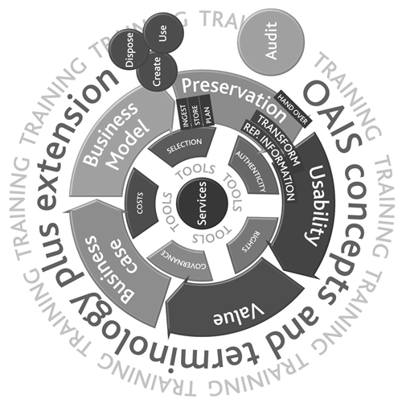
APARSEN Elevator Pitch
The challenge: We love models!
The solution: Another model?
Provenance model
Cost model
Business model
Policy models
Lifecycle model
Knowledge models
Virtualisation model
OAIS model

Slide 4
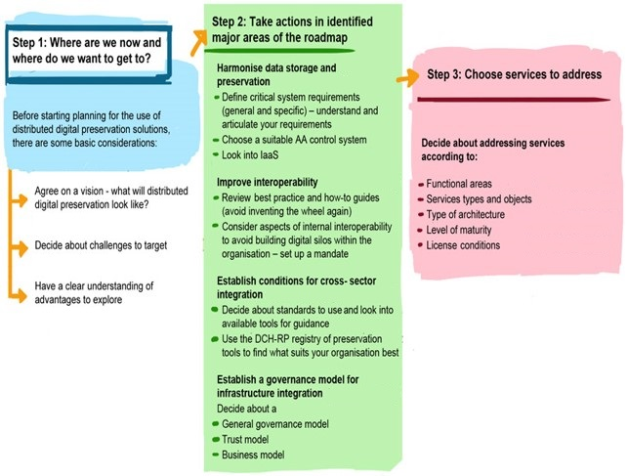
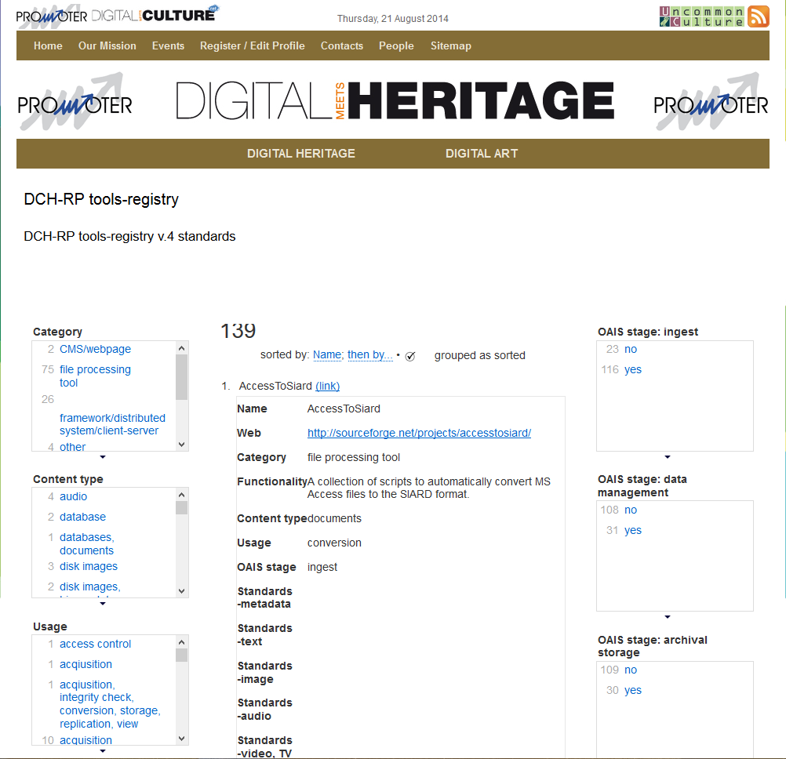
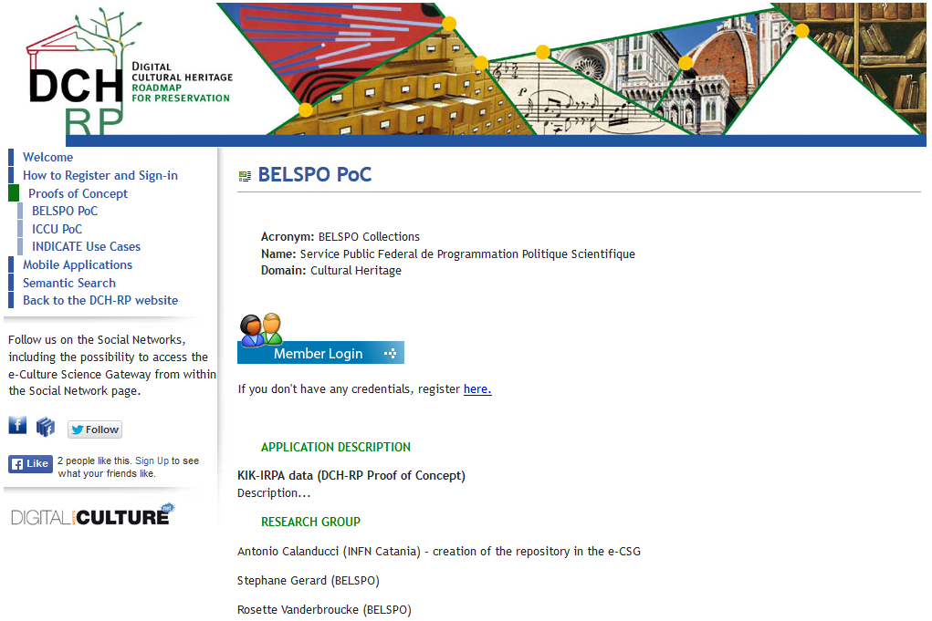
Digital Cultural Heritage: Roadmap for Preservation
Roadmap to help policy makers and programme owners to take decisions related to digital preservation and to support CH institutions in defining practical action plan with a realistic time frame for its implementation
Registry with information, assessments and reviews about the tools that may be used to implement common user scenarios
Proofs of Concept where CH institutions experiment the use of distributed computing and storage infrastructures, services and tools to store and manage cultural digital resources

Slide 5
Digital Preservation Sustainability on the EU Policy Level
DL2014
At a Glance
Not-for-profit membership organisation, providing:
  knowledge exchange
  capacity building
  assurance
  advocacy
  partnership
Engagement with DPC members to discern needs
Distribution of research and development
Advocacy
Awareness Raising:
  research data
  personal archives
  government archives
  valuable digital resources held by businesses and institutions
Promotion of a community of experts and practitioners

Slide 6
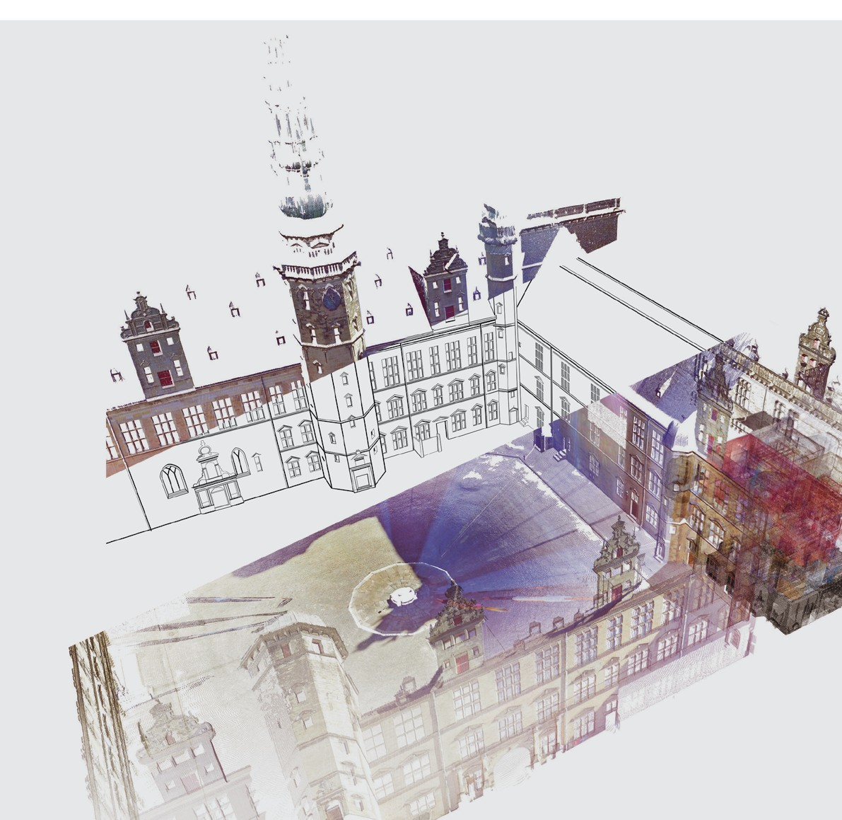
Preservation of 3D objects of buildings
Durable Architectural Knowledge
Devinder Thapa, Luleå University of Technology

Slide 7

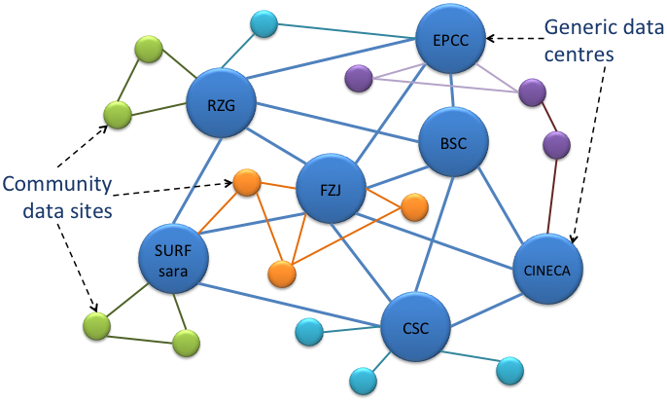
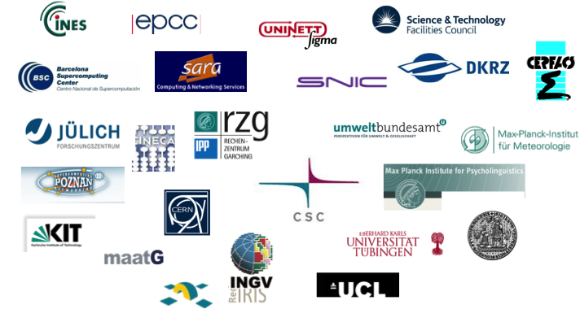
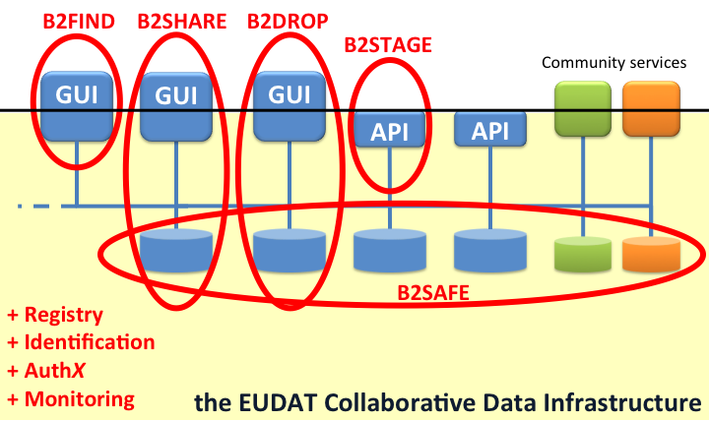
The underpinning infrastructure
for European research data
“B2” – a suite of
common data services
A common metadata catalogue for all archived and shared data.
A common baseline metadata set across all archived data.
GUI-based search and discovery tools and a rich programmatic query interface.
Policy-based data management.
Replication across European data centres.
Safety, accessibility and convenience.
A general-purpose service for easy upload and sharing of long tail research data.
An open repository for depositing research data.
A collaboration platform for sharing data in a secured way.
A personal cloud storage solution based in the trusted CDI domain.
Store and share datasets in the early stages of the research data life cycle.
Interoperable with other cloud storage environments.
APIs to customise and optimise data flow to and from the CDI.
An HTTP interface for data, metadata and persistent identifiers.
A GridFTP interface for high-performance data transfer.

Slide 8
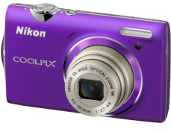
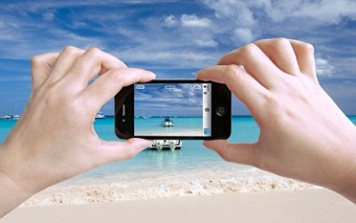




Forgetting and remembering in the Digital Age
  Capturing of life situations: easy, cheap, popular + possible everywhere
→ photos and videos for various events and situations in life
  Digital content such as emails are created for professional and
  private purposes on daily basis
  Large amounts of photos, ideas, daily information, videos, etc. shared in Social Networks
  What will happen to this abundance of content in the long run?
in 1 year
5 years
10 years
20 years
...
over generations
Notes:
snapchat

Slide 9


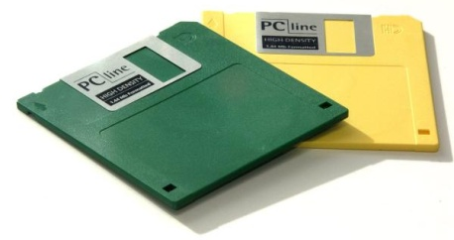
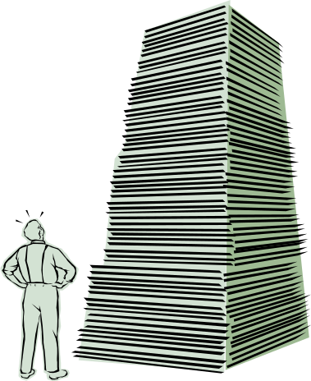
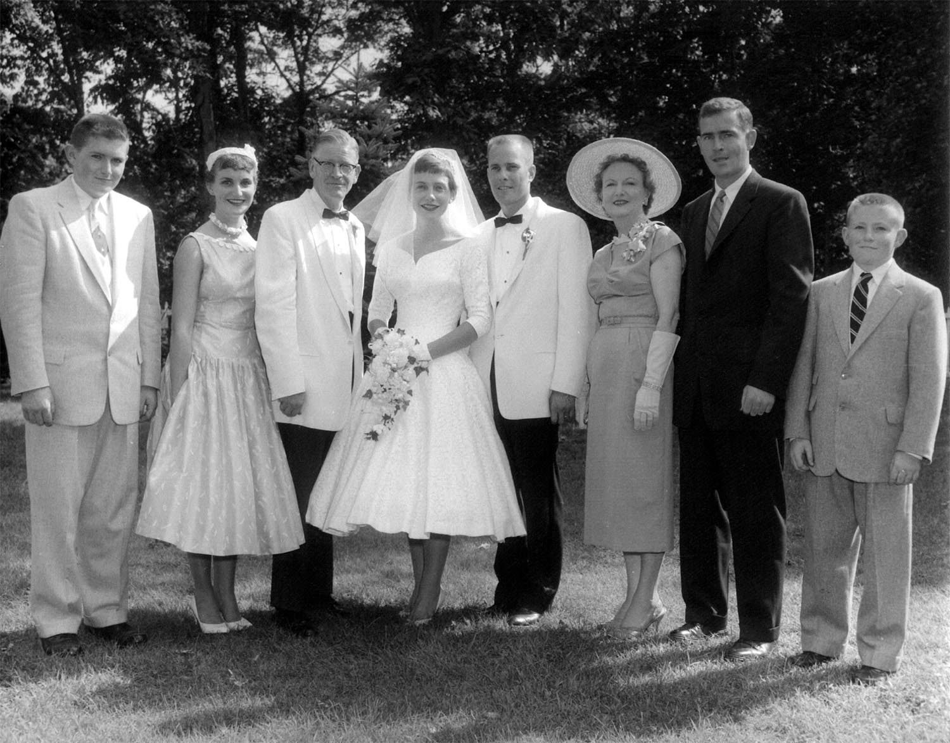
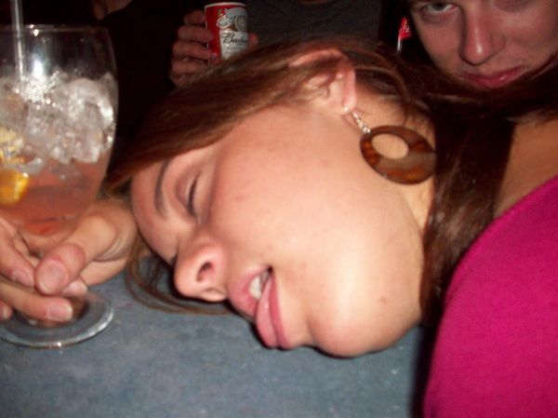
Advocates the dominating “keep it all” strategy
Technological developoment
What will happen
to the content?
Do you still remember?
Information overload:
What to remember?
Do you want to remember?
Who was this guy ...?
... and would you like future employers to see?
9
Alternative:
Really keep the important things and keep them
understandable and useful
➔ A random form of forgetting content

Slide 10
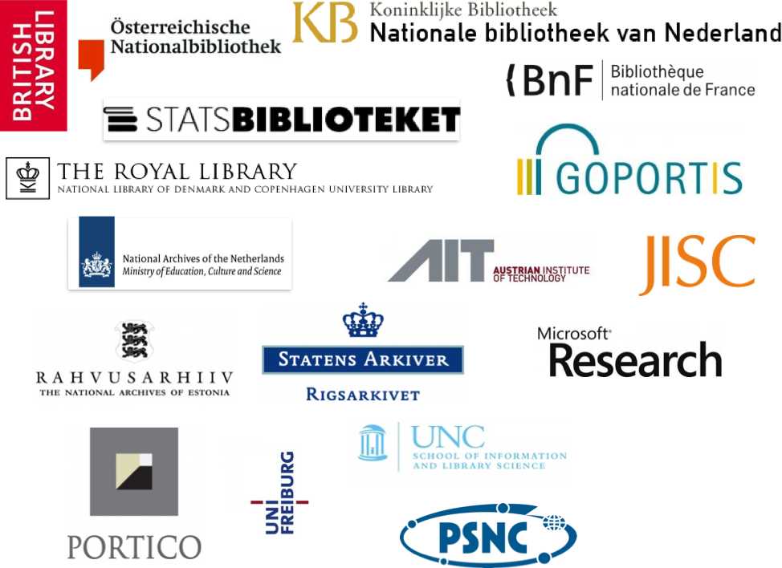







connecting digital preservation expertise
Events
hackathons
webinars
training
Technology
Knowledge
Case studies
Best practices
Policy catalogue
Business cases
Services
tools registry
peer review
Q&A
Advocacy
Alliances
Memory Institutions
Software stewardship
sustainability + maturity
efficiency + consistency
collaboration + trust
Research & Development
Service Providers
Community
project sustainability
collaborative development

Slide 11

RSS Overview
Research and Service Support
Task | Deliverables
EO Research Support (Algorithm development) | Processing resources, datasets, algorithm integration/wrapper, output data, mosaicking, toolboxes, user support
Value added data production | On-demand production, systematic production, re-processing campaigns, data delivery
Testbeds support | Requirements definition support, testbed design, testbed implementation, user support
EO Services Support (Value added services) | Service Support Environment operations, service providers support, users support, products delivery
E-collaboration support | Join&Share area operations (Wiki, Forums, Blog)
OGC services | WMS, WFS, WFS-T, WCS operations
Technology development Support | Requirements definition support, Project reviews support, applications validation, TTO
Communication support | RSS Portal/J&S operations, Virtual Reality Theatre shows, Demo Room presentations

Slide 12
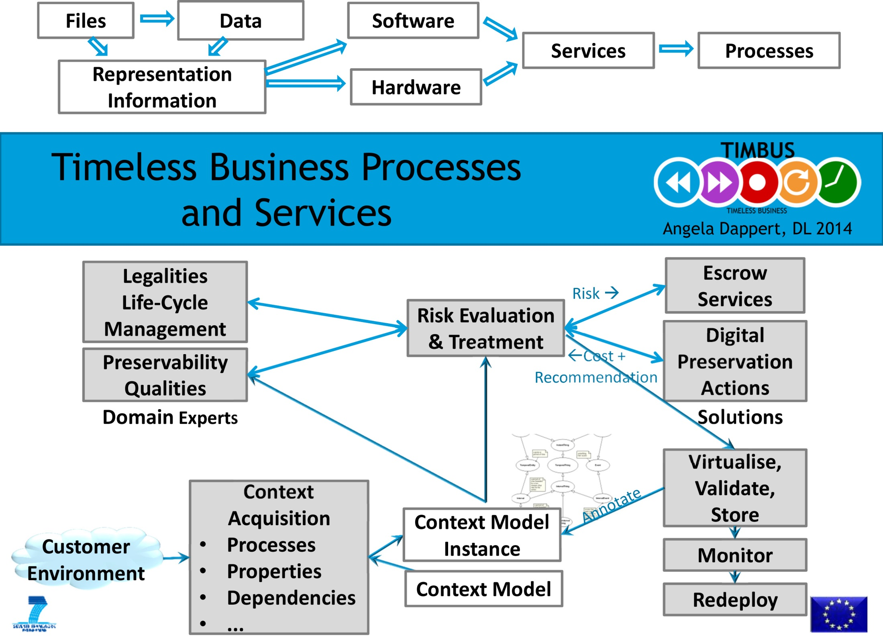

Slide 13

Preservation – because things change and so….
we need to:
  Know something has changed
  Understand the implications of that change
  Decide on the best course of action for preservation
  What RepInfo we need to fill the gaps
    Created by someone else or creating a new one
  If transformed: how to maintain data authenticity
  Alternatively: hand it over to another repository
  Make sure data remains usable
Orchestration Service
Gap Identification Service
Preservation Strategy Tk
RepInfo Registry Service
RepInfo Toolkit
Authenticity Toolkit
Packaging Service
RepInfo Toolkit
Science Data E-Infrastructure for Preservation www.scidip-es.eu
Data Virtualisation Toolkit
Process Virtualisation Toolkit
Notes:
We want to emphasize here that there is a need for specific preservation software and start giving some names to things.

